Slide 1
PLAN Primary Science – Supporting Assessment
Everyday Materials Year 2-Glory
© Pan London Assessment Network (PLAN) July 2019
This resource has been developed by the Pan London Assessment Network and is supported by the Association for Science Education.

Slide 2
PLAN Primary Science - Supporting Assessment
PLAN Primary Science is a set of resources produced to enable teachers to have a clearer understanding of National Curriculum expectations for meeting the standard. Annotated collections of children’s work provide examples of what working at the expected standard for primary science might look like for the knowledge and conceptual understanding statements of the programmes of study (POS).
It is not the intention of these resources to specifically exemplify the working scientifically statements. However, aspects of working scientifically have been shown as an integral part of the teaching and learning of the knowledge and concepts.
The resources provided have been cross moderated multiple times before publishing so that they can be used with confidence by teachers and subject leaders.
Each collection of work shows one example of how a pupil has met National Curriculum statements for a particular area of content but these are not intended to be the definitive way of teaching these statements.

Slide 3
Structure of the resources
Each resource contains the relevant National Curriculum statements for the unit of work and prior learning, a planning matrix, annotated work and a summary sheet. The matrix provides an interpretation of the key learning of the National Curriculum statements, and suggestions of key vocabulary. In order to be meet the expectations pupils must firstly understand the key concept and then be provided with opportunities to apply that knowledge. This is a key planning tool.
 |  | Key Learning | Possible Evidence
Secure | Show understanding of a concept by using scientific vocabulary correctly | Overview paragraph describing curriculum Key vocabulary – list of words | Possible ways to demonstrate key learning, particularly correct usage of vocabulary
 | Apply knowledge in familiar related contexts, including a range of enquiries | Suggestions of contexts to use. | Possible ways to demonstrate that a pupil has gone beyond recall of facts and can apply the key learning, for example using the vocabulary and basic principles to produce explanations, usually within Working Scientifically contexts.

Slide 4
Contents of the materials
Please note: The NC statements for each topic area for the relevant year group are stated on the slide. Only the statements in bold on that slide have been exemplified. In these cases the teachers have chosen to split the statements within the topic area to teach at different times.
The prior NC statements relevant to the topic area are also stated and use to determine pupils’ knowledge at the start of the unit.
Each slide has been annotated with coloured text. Please see key below:
Red Commentary to explain how evidence meets/does not meet NC statements
Blue Commentary to highlight features of working scientifically
Green Pupil Speak
Grey Other relevant information eg. vocabulary used

Slide 5
Year 1 statements – prior learning
Year 1 Statement – Prior learning
Pupils should be taught to:
distinguish between an object and the material from which it is made (1-Everyday materials)
identify and name a variety of everyday materials, including wood, plastic, glass, metal, water, and rock (1-Everyday materials)
describe the simple physical properties of a variety of everyday materials (1-Everyday materials)
compare and group together a variety of everyday materials on the basis of their simple physical properties. (1-Everyday materials)

Slide 6
Year 2 statements
Year 2 Statement
Pupils should be taught to:
identify and compare the suitability of a variety of everyday materials, including wood, metal, plastic, glass, brick, rock, paper and cardboard for particular uses (2-Everyday materials)
find out how the shapes of solid objects made from some materials can be changed by squashing, bending, twisting and stretching. (2-Everyday materials)

Slide 7
Later Statements
Pupils do not need to be taught content they will learn in later year groups. They can be challenged by applying the content for their year group in broader contexts.
In Year 3 pupils will be taught to:
compare and group together different kinds of rocks on the basis of their appearance and simple physical properties. (3-Rocks)
notice that some forces need contact between 2 objects, but magnetic forces can act at a distance. (3-Forces)
In Year 5 pupils will be taught to:
compare and group together everyday materials on the basis of their properties, including their hardness, solubility, transparency, conductivity (electrical and thermal), and response to magnets (5-Properties of everyday materials)
give reasons, based on evidence from comparative and fair tests, for the particular uses of everyday materials, including metals, wood and plastic. (6-Properties of everyday materials)

Slide 8
This work on materials was taught in 2 units, one in the autumn term, the other in spring. The focus for the autumn term was particularly on the first curriculum statement, revisiting and extending properties of materials (from Y1) and linking them to uses, although properties relating to shaping materials were introduced. Some of the work was related to the class theme of pirates.
At the end of the first unit the teacher identified that, in addition to more teaching relating to the second curriculum statement, the children needed further experiences of testing properties to provide contexts for embedding new vocabulary and to develop aspects of working scientifically.

Slide 9
 |  | Key Learning | Evidence
Secure | Show understanding of a concept by using scientific vocabulary correctly | The properties of materials (prior learning from Y1) make them suitable or unsuitable for particular purposes. When choosing what to make an object from, the properties needed are compared with the properties of the possible materials, identified through simple tests and classifying activities. More than one material may be suitable. A material can be suitable for different purposes. Some objects can be bent, stretched, squashed and twisted. This can be a property of the material or depend on how the material has been processed e.g. thickness Key vocabulary Names of materials: wood. Plastic, glass, metal, water, rock, brick, paper, fabric, card, rubber; suitable/unsuitable, use/useful, hard/soft, stretchy/stiff, rigid/flexible, waterproof/absorbent, strong/weak, rough/smooth, transparent/opaque, shape, push/pushing, pull/pulling, twist/twisting, squash/squashing, bend/bending, stretch/stretching. | Can name an object, say what material it is made from, identify its properties and make a link between the properties and this particular use. For a given object can identify what properties a suitable material needs to have Whilst changing the shape of an object can describe the actions used. Can use the words flexible and/or stretchy to describe materials that can be changed in shape and stiff and/or rigid for those that cannot.
 | Apply knowledge in familiar related contexts | Explain why a material is suitable or unsuitable for a particular purpose Carry out simple tests to determine the properties of materials Identify, with reasons, possible uses for a given material Recognise that a material may come in different forms which have different properties. | Can explain using the key properties why they chose a particular material for a purpose. For unusual combinations of material and object can explain, using key properties, why the material is suitable or unsuitable Can justify their choice of a material for a purpose by referring to the results of simple tests they have carried out on relevant properties. Can describe more than one use for a given material Can describe differences in the properties of objects made from the same material

Slide 10
Initial assessment activity – to check what children can remember from Y1
Distinguish between an object and the material from which it is made
Identify and name a variety of everyday materials, including wood, plastic, glass, metal, water and rock
Following a discussion, children were asked to draw a title page showing what they knew about materials.
Another child, Jayden also showed he was able to use vocabulary for properties although he did not associate them with specific materials
Glory has drawn objects and labelled some of them with the material from which it is made. He has listed several common materials and is secure in this Y1 content.

Slide 11
Review of learning from Y1
Describe the simple physical properties of a variety of everyday materials
Children first used adjectives to describe materials in a feely bag, which Glory was able to do using all vocabulary expected for Y1. Then they independently identified objects around the classroom and described the materials they were made from.
Further evidence of Y1 distinguishing object and material. Only one property identified.
Evidence of simple identifying and classifying.
Verbal response – rough, solid
Unlike Glory, Jayden used some adjectives to describe the materials and objects he saw

Slide 12
Materials hunt
Identify and describe the suitability of a variety of everyday materials, including wood, metal, glass, brick, rock, paper and cardboard for particular uses
The teacher now realises that task sheet is not specific about needing to use adjectives – this will be changed next year
He is describing how the object functions rather than justifying the choice of material so is not showing he can describe suitability for purpose
During discussions Glory used a wide range of properties words including transparent and opaque. This vocabulary is not reflected in his written work but shows he is secure in the use of Y1 vocabulary for properties.

Slide 13
Good choices?
Identify and describe the suitability of a variety of everyday materials, including wood, metal, glass, brick, rock, paper and cardboard for particular uses
Linking unsuitability of material to properties.
This shows understanding of the word opaque.
More confident explaining why a material is unsuitable than suitable
By explaining which properties make a material unsuitable for a use Glory shows understanding of how properties relate to uses. He is able to describe a range of properties using correct scientific vocabulary.

Slide 14
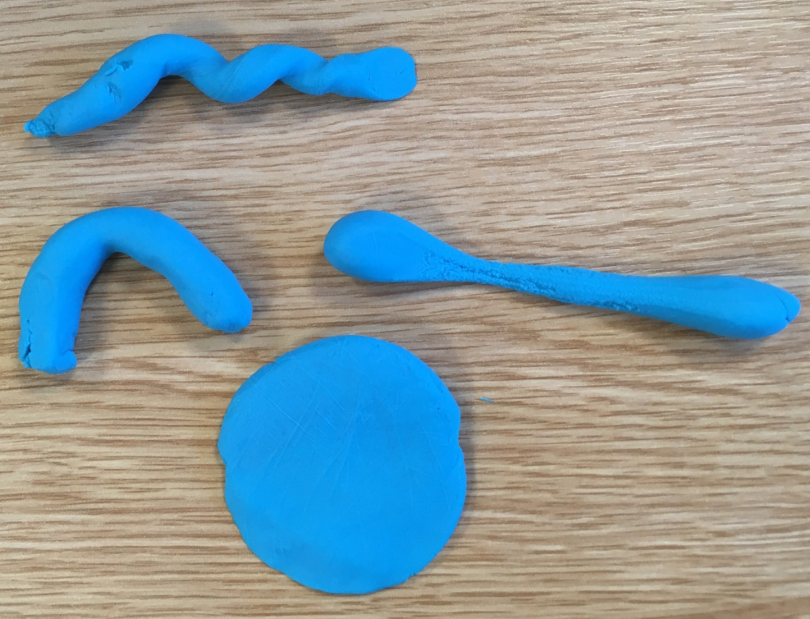
Investigating how materials can be shaped
Find out how the shapes of solid objects can be changed by squashing, bending, twisting and stretching
In the previous activities several children used the words flexible, rigid and stretchy but not with consistent meaning. In this activity children matched vocabulary to actions when manipulating dough and talked about how some materials can be changed and the properties of those materials.
Teacher: How did you change this one?
Glory: I changed it by bending. Play dough is bendy.
Teacher: Is there another word for bendy?
Glory: Flexible.’
I twisted this one.
I pulled and stretched it. It is stretchy. It nearly broke.
I squashed it flat with my hand.
Glory is able to name and demonstrate the actions of squashing, bending, twisting and stretching but is not confidently using flexible, rigid, stretchy and stiff.

Slide 15
Investigating how materials can be shaped
Identify and describe the suitability of a variety of everyday materials, including wood, metal, glass, brick, rock, paper and cardboard for particular uses
Children were then set a problem linked to their pirate theme, with a focus on the properties of stretchiness/stiffness and flexibility/rigidity.
Simple linking of properties to uses, thinking about flexibility
Glory is now also considering properties that make a material suitable for a purpose but is not yet using the new properties
vocabulary.
belt
comfortable

Slide 16
Inventing a new use for a material
Identify and describe the suitability of a variety of everyday materials, including wood, metal, glass, brick, rock, paper and cardboard for particular uses
Children were given an object and asked to think of a new use for the material it was made from. Glory had a paperclip.
Glory is still not writing the vocabulary he uses in discussions but this work shows that he recognises that the same material can be used for different purposes. He also recognises that metal in the form of a cutlass will not bend in the same way that a paperclip does.
Verbal response: bend and twist

Slide 17
Investigating suitability of materials
Identify and describe the suitability of a variety of everyday materials, including wood, metal, glass, brick, rock, paper and cardboard for particular uses
Children decided as a class which properties to test. Flexibility and stretchiness were tested individually, waterproof was an interactive demonstration.
In discussion the teacher identified that Glory was confusing flexible with elastic.
Glory has identified the most suitable material based on the properties tested, linking them to the purpose of a tent cover. His conclusion is more detailed than his prediction. His findings show that he is not yet secure in his understanding of flexible.
Glory can carry out simple tests and has recorded data in a prepared table and used it to answer his question.

Slide 18
Materials part 2: Shaping materials
Find out how the shapes of solid objects can be changed by squashing, bending, twisting and stretching
Glory has completed very little of the activity so has not explored all relevant properties.
The metal test tube holder bends a bit but the chair legs don’t because they are stronger and thicker.
He recognises that flexibility is a property of the object not the material.
In contrast, Jayden’s work shows that he has explored materials which can bend, twist, squash and stretch and can make comparisons. He understands elasticity although he is not using the word.

Slide 19
Investigating how materials can be shaped
Identify and describe the suitability of a variety of everyday materials, including wood, metal, glass, brick, rock, paper and cardboard for particular uses
Find out how the shapes of solid objects can be changed by squashing, bending, twisting and stretching
Mostly correct identification of properties related to uses – shows understanding of vocabulary. Now secure on flexible.
Discussion with him about the dog lead showed confusion between stretchy and extendable (at home, he has a dog lead which reels in and out).
Mostly suitable materials chosen on the basis of properties.
Glory is able to use correct vocabulary for properties relating to changing shape and use these to select materials for purposes.

Slide 20
Overall Summary
Overall summary – secure
Glory has shown consistently that he can name the materials from which different objects are made and talk about properties using a wide vocabulary, although his written work does not always reflect this. He recognises suitable and unsuitable choices of material. He can identify what properties a material needs for a particular purpose and is able to test those properties before making his choice. He can change the shape of objects using named actions and can choose different purposes for the same material, showing he recognises that shaping it in a different way affects the rigidity of the object.

Slide 21
Acknowledgements
Acknowledgements

