Slide 1
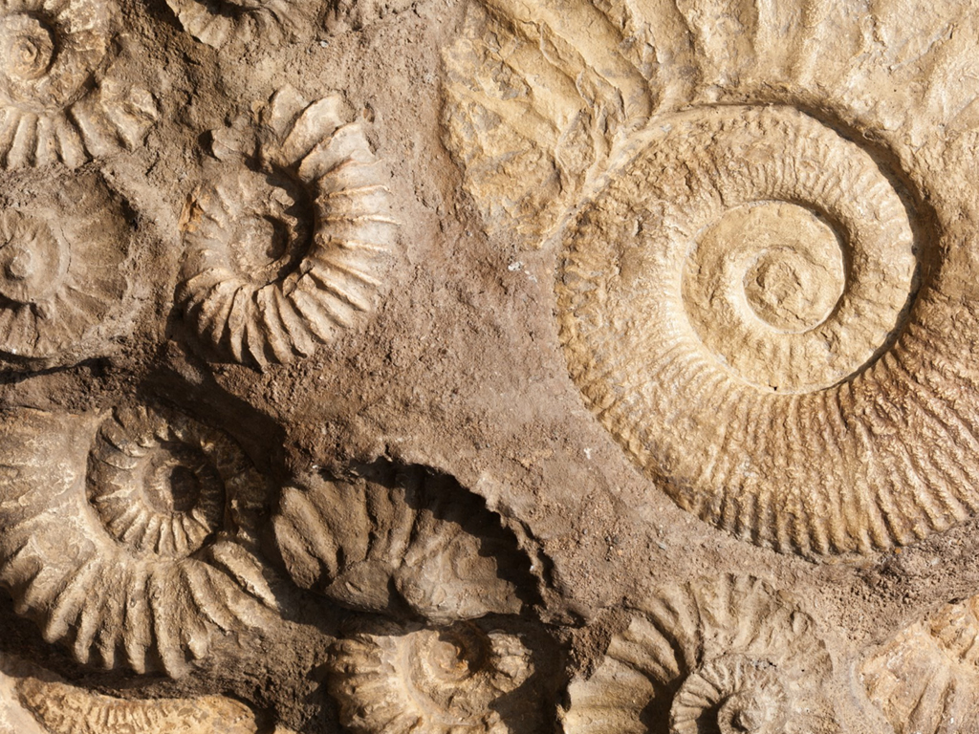
PLAN Primary Science – Supporting Assessment
Rocks Year 3-J.R.
© Pan London Assessment Network (PLAN) July 2019
This resource has been developed by the Pan London Assessment Network and is supported by the Association for Science Education.

Slide 2
PLAN Primary Science - Supporting Assessment
PLAN Primary Science is a set of resources produced to enable teachers to have a clearer understanding of National Curriculum expectations for meeting the standard. Annotated collections of children’s work provide examples of what working at the expected standard for primary science might look like for the knowledge and conceptual understanding statements of the programmes of study (POS).
It is not the intention of these resources to specifically exemplify the working scientifically statements. However, aspects of working scientifically have been shown as an integral part of the teaching and learning of the knowledge and concepts.
The resources provided have been cross moderated multiple times before publishing so that they can be used with confidence by teachers and subject leaders.
Each collection of work shows one example of how a pupil has met National Curriculum statements for a particular area of content but these are not intended to be the definitive way of teaching these statements.

Slide 3
Structure of the resources
Each resource contains the relevant National Curriculum statements for the unit of work and prior learning, a planning matrix, annotated work and a summary sheet. The matrix provides an interpretation of the key learning of the National Curriculum statements, and suggestions of key vocabulary. In order to be meet the expectations pupils must firstly understand the key concept and then be provided with opportunities to apply that knowledge. This is a key planning tool.
 |  | Key Learning | Possible Evidence
Secure | Show understanding of a concept by using scientific vocabulary correctly | Overview paragraph describing curriculum Key vocabulary – list of words | Possible ways to demonstrate key learning, particularly correct usage of vocabulary
 | Apply knowledge in familiar related contexts across a range of enquiry types | Suggestions of contexts to use. | Possible ways to demonstrate that a pupil has gone beyond recall of facts and can apply the key learning, for example using the vocabulary and basic principles to produce explanations, usually within Working Scientifically contexts.

Slide 4
Contents of the materials
Please note: The NC statements for each topic area for the relevant year group are stated on the slide. Only the statements in bold on that slide have been exemplified. In these cases the teachers have chosen to split the statements within the topic area to teach at different times.
The prior NC statements relevant to the topic area are also stated and use to determine pupils’ knowledge at the start of the unit.
Each slide has been annotated with coloured text. Please see key below:
Red Commentary to explain how evidence meets/does not meet NC statements
Blue Commentary to highlight features of working scientifically
Green Pupil Speak
Grey Other relevant information eg. vocabulary used

Slide 5
Y1 Statements – Prior Learning
Pupils should be taught to:
distinguish between an object and the material from which it is made (1-Everyday Materials)
identify and name a variety of everyday materials, including wood, plastic, glass, metal, water, and rock (1-Everyday Materials)
describe the simple physical properties of a variety of everyday materials (1-Everyday Materials)
compare and group together a variety of everyday materials on the basis of their simple physical properties (1-Everyday Materials)

Slide 6
Y2 Statements – Prior Learning
Pupils should be taught to:
identify and compare the suitability of a variety of everyday materials, including wood, metal, plastic, glass, brick, rock, paper and cardboard for particular uses (2-Everyday Materials)

Slide 7
Y3 Statements
Pupils should be taught to:
compare and group together different kinds of rocks on the basis of their appearance and simple physical properties (3-Everyday Materials)
describe in simple terms how fossils are formed when things that have lived are trapped within rock (3-Everyday Materials)
recognise that soils are made from rocks and organic matter (3-Everyday Materials)

Slide 8
Later Statements
Pupils do not need to be taught content they will learn in later year groups. They can be challenged by applying the content for their year group in broader contexts.
In Year 6 Evolution and inheritance pupils will be taught to:
Recognise that living things have changed over time and that fossils provide information about living things that inhabited the Earth millions of years ago. (6-Evolution and Inheritance)

Slide 9
 | Assessment guidance | Key learning | Possible Evidence
SECURE | Shows understanding of a concept using scientific vocabulary correctly | Rock is a naturally occurring material. There are different types of rock e.g. sandstone, limestone, slate etc. which have different properties. Rocks can be hard or soft. They have different sizes of grain or crystal. They may absorb water. Rocks can be different shapes and sizes (stones, pebbles, boulders). Soils are made up of pieces of ground down rock which may be mixed with plant and animal material (organic matter). The type of rock, size of rock piece and the amount of organic matter affect the property of the soil. Some rocks contain fossils. Fossils were formed millions of years ago. When plants and animals died, they fell to the seabed. They became covered and squashed by other material. Over time the dissolving animal and plant matter is replaced by minerals from the water. Key vocabulary: Rock, stone, pebble, boulder, grain, crystals, layers, hard, soft, texture, absorb water, soil, fossil, marble, chalk, granite, sandstone, slate, soil, peat, sandy/chalk/clay soil | Can name some types of rock and give physical features of each Can explain how a fossil is formed Can explain that soils are made from rocks and also contain living/dead matter
 | Applying knowledge in familiar related contexts, including a range of enquiries | Observe rocks closely Classify rocks in a range of ways based on their appearance Devise a test to investigate the hardness of a range of rocks Devise a test to investigate how much water different rocks absorb Observe how rocks change over time e.g. gravestones or old building Research using secondary sources how fossils are formed Observe soils closely Classify soils in a range of ways based on their appearance Devise a test to investigate the water retention of soils Observe how soil can be separated through sedimentation Research the work of Mary Anning | Can classify rocks in a range of different ways using appropriate vocabulary Can devise tests to explore the properties of rocks and use data to rank the rocks Can link rocks changing over time with their properties e.g. soft rocks get worn away more easily Can present in different ways their understanding of how fossils are formed e.g. in role play, comic strip, chronological report, stop-go animation etc. Can identify plant/animal matter and rocks in samples of soil Can devise a test to explore the water retention of soils

Slide 10
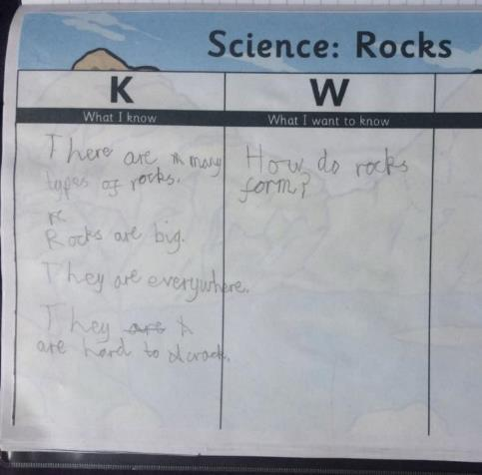
Initial assessment of prior knowledge of rocks
compare and group together different kinds of rocks on the basis of their appearance and simple physical properties
The children were asked to record any knowledge about rocks that they had prior to starting the unit.
J.R. has little current knowledge of the different types of rocks. He is not using the specific scientific vocabulary for this topic. He shows no prior knowledge of the uses of rocks.
Because of the unit title on the KWL grid J.R. focused only on rocks and did not consider fossils or soils.
JR recognises a property of rocks.

Slide 11
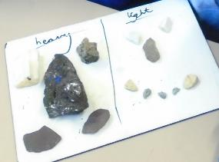
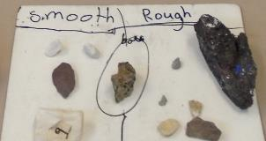
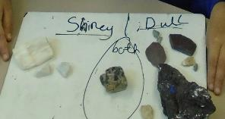
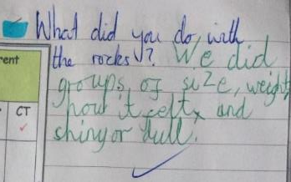
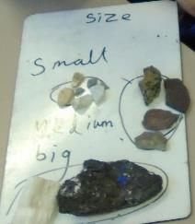
Comparing and grouping rocks
Compare and group together different kinds of rocks on the basis of their appearance and simple physical properties
The children worked in groups to sort the rocks in different ways using their own criteria.
J.R made simple observations and classified rocks using his own criteria, recording with discrete and overlapping sets
medium
J.R’s group has sorted the rocks by texture, size, appearance and weight,

Slide 12
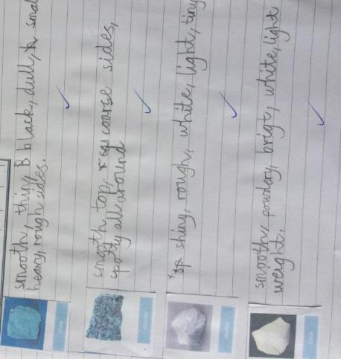
Describing the simple properties of rocks
compare and group together different kinds of rocks on the basis of their appearance and simple physical properties
After grouping the rocks, the children took a closer look at the different types of rock describing them in more detail
J.R. used a wider range of vocabulary to describe the appearance and simple physical properties of a selection of rocks.

Slide 13
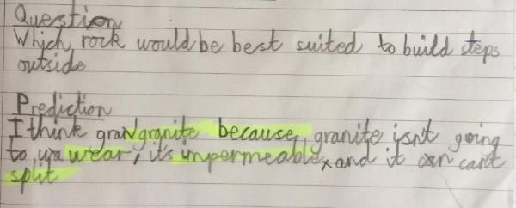
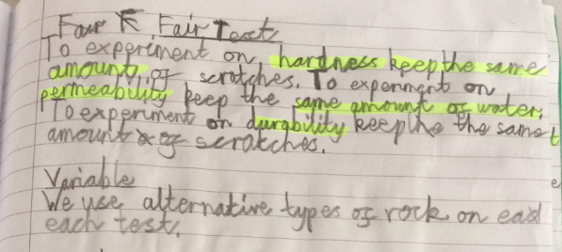
Testing the properties of rocks
Compare and group together different kinds of rocks on the basis of their appearance and simple physical properties
The children were presented with the question ‘Which rock would be best suited to build steps outside?’
First the children identified the properties that the rock would need. Then they planned and carried out a series of comparative tests to determine the most suitable rock for the purpose.
J.R. used his knowledge of properties and his previous observations of rocks to make a prediction. He set up a comparative test, identifying variables to change and control.
The actual test involved rubbing

Slide 14
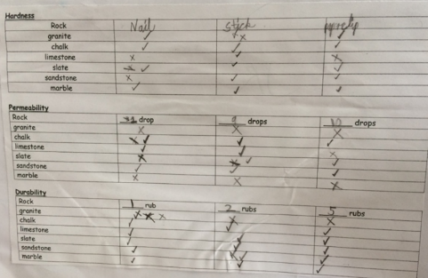
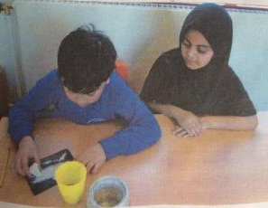
Testing the properties of rocks (continued)
Compare and group together different kinds of rocks on the basis of their appearance and simple physical properties
J.R. awarded marks to the rocks for each property based on the number of crosses in the row. For durability 3 crosses for granite shows that it is durable (in all three rub tests there was no marking); for permeability 3 crosses indicates that it is not permeable as a cross indicates that no water soaked in.
J.R. tested and understood the properties of hardness, permeability and durability and applied his knowledge to select a rock that is suitable for purpose.
J.R. recorded his data on a prepared table. He drew a conclusion from his results which answers the original question.

Slide 15
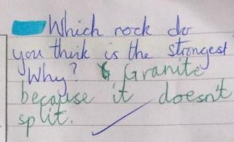
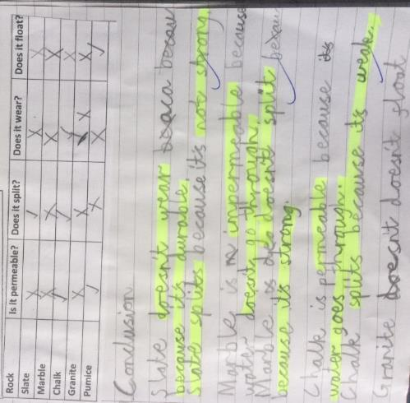
Properties of rocks
compare and group together different kinds of rocks on the basis of their appearance and simple physical properties
To consolidate their understanding and explore a wider range of properties the children conducted a ‘virtual experiment’ and recorded the results.
J.R. wrote statements about the rocks which are consistent with the data
J.R. compared the rocks and gave simple definitions of the properties. His answer to the marking question uses evidence from the experiment but this activity did not require him to apply this knowledge.

Slide 16
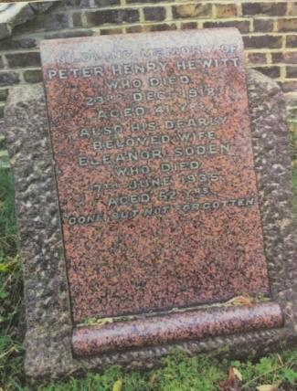
Observing rocks in the environment
compare and group together different kinds of rocks on the basis of their appearance and simple physical properties
The class went on a walk to a local church and its cemetery to observe the uses of a range of types of rock and changes to them over time.
Marble is a good rock for graves because it does not wear away and you can read the names. Sandstone wears away so it is harder to read.
In the churchyard J.R. noted that there were many different types of rock, identified and described them. He could identify different types of rock and why they had been used. In his report he showed simple understanding of weathering and permeability.

Slide 17
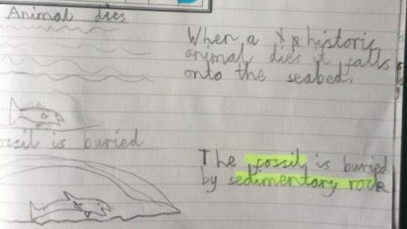
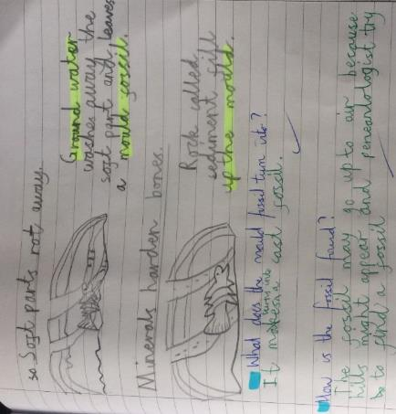
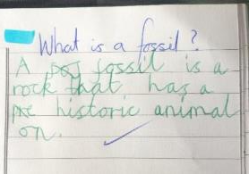
Researching fossil formation
describe in simple terms how fossils are formed when things that have lived are trapped within rock
After watching some videos, the class discussed the stages of fossil formation and recorded the process in their own words.
Is it a fossil?
Not until the animal has rotted away.
J.R. described the sequence of fossil formation in his own words using scientific vocabulary. He also knows why buried fossils appear at the surface.
J.R defined a fossil in his own words.

Slide 18
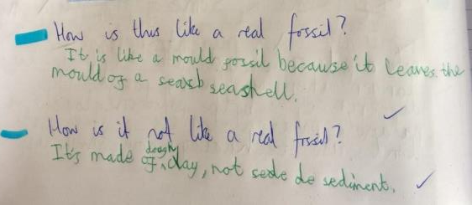
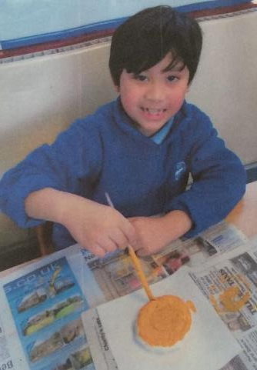
Modelling fossil formation
describe in simple terms how fossils are formed when things that have lived are trapped within rock
The children made their own fossils by pressing a shell into clay and making a plaster cast.
JR applied his knowledge of the process of fossil formation to make simple comparisons between his model fossil and the real ones

Slide 19
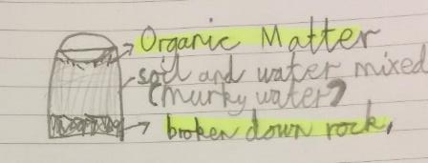
Separating the components of soil
Recognise that soils are made from rocks and organic matter
The children filled a cup/bottle a quarter full of soil and topped it up to three quarters full with water. They then shook it, to mix it. The children observed this over a period of time as it separated showing what the soil was made from. They were then asked to record their observations.
J.R. presented his observations as a labelled diagram.
J.R. correctly labelled the main components of the soil and wrote a simple description of how soil is formed. He described what organic matter is.

Slide 20
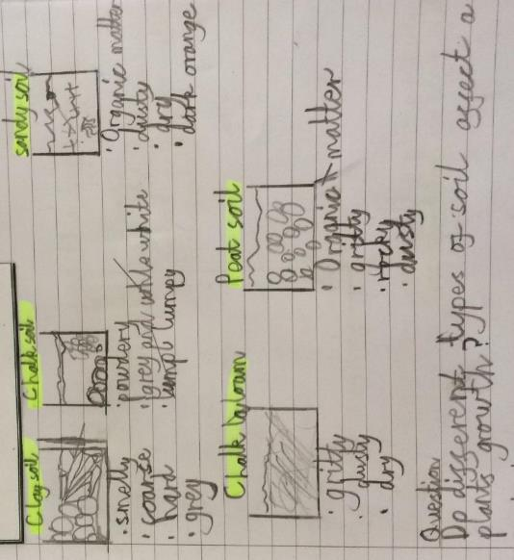
Exploring different soils
Recognise that soils are made from rocks and organic matter
As part of a later unit on plants the children made observations of the characteristics of different soil types.
J.R. used drawings and notes to record his observations of the soils.
J.R. remembered the components of soil and identified them in some of the different soil types.
The children were asked to think how this activity might link to their current topic of plants.
In response J.R. wrote this question.

Slide 21
Investigating how plants grow in different soils
Recognise that soils are made from rocks and organic matter
The children then set up a test to answer their question.
J.R. used his knowledge of the constituents of soil and the needs of plants to make a prediction. He also identified control and independent variables.
J.R demonstrates an understanding that plants require nutrients and to be anchored in the ground (plants statement).

Slide 22
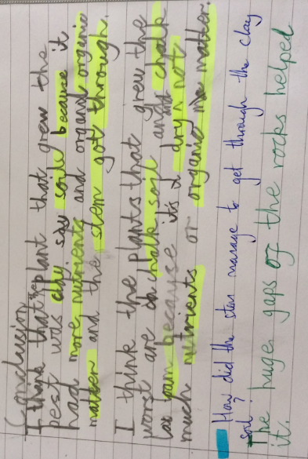
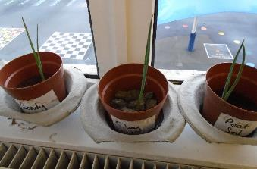
Investigating how plants grow in different soils
Recognise that soils are made from rocks and organic matter
J.R. compared the water holding properties of the different soils and demonstrates again that he understands that soils contain organic matter. His observations of the effect of grain size were linked to his observations of the stems emerging.
J.R. links his knowledge of what plants need to grow and his observations of the characteristics of the different soils when drawing a conclusion.

Slide 23
Completion of KWL grid – final reflection on learning
Why is chalk used for drawing?
Because it is soft and crumbly so it rubs off.
J.R. refers to properties and uses of rocks although he does not link them until prompted. He includes more information about fossils but does not refer to soils.

Slide 24
Overall summary – secure
Overall summary – secure
J.R. can use a range of criteria to sort and compare rocks. He has used observations and tests to extend his knowledge of their properties and he can apply his knowledge to suggest which rocks are best suited to particular purposes. J.R. can sequence the stages of fossil formation and uses his knowledge in his comparison of a real and model fossil. J.R knows the constituents of soil and recognises that not all soils are the same. He can apply this knowledge in the context of growing plants.
.

Slide 25
Acknowledgements

