Slide 1
THE GREAT VACCINE DEBATE
© ASE and James Films
This activity was produced by the Association for Science Education
in partnership with James Films

Slide 2
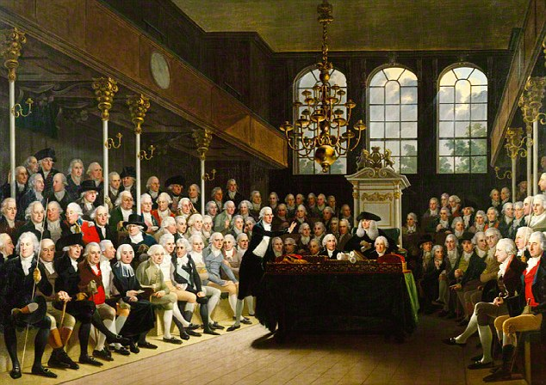
THE GREAT VACCINE DEBATE

Slide 3
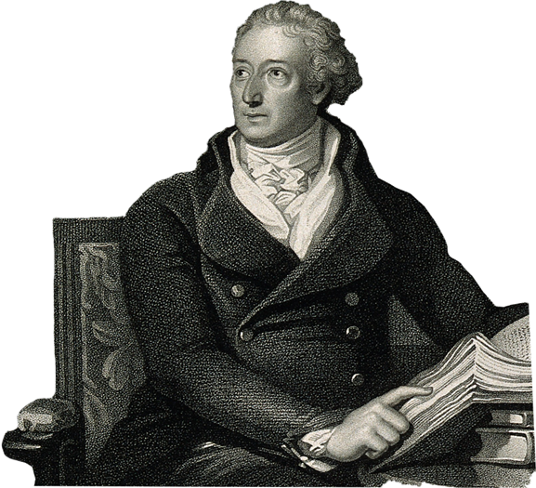
SOURCE A
“Can any person say what may be the consequence of introducing a bestial humour into the human frame?”
Dr Benjamin Moseley
a bestial humour | = an animal illness
the human frame | = the human body

Slide 4
Who can tell what will happen when you put an animal disease into the human body?

Slide 5
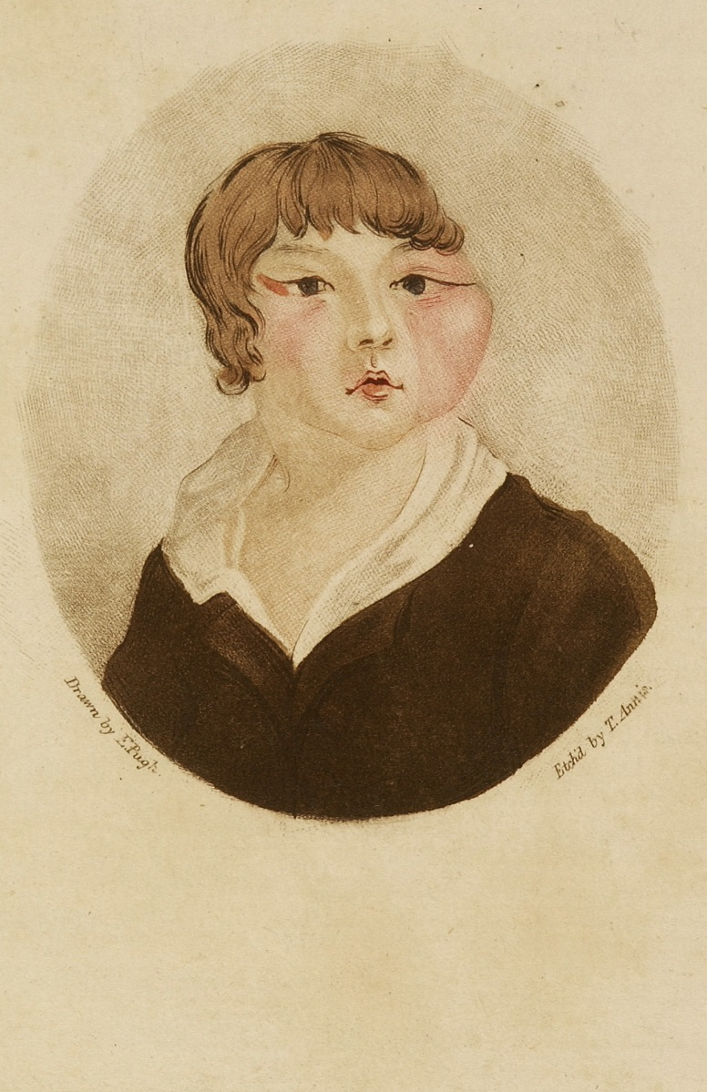
SOURCE B
from a book called:
Cowpox inoculation is no security against smallpox infection : with over 500 proofs of failure
by Dr William Rowley
Cow-poxed, Ox-faced boy

Slide 6
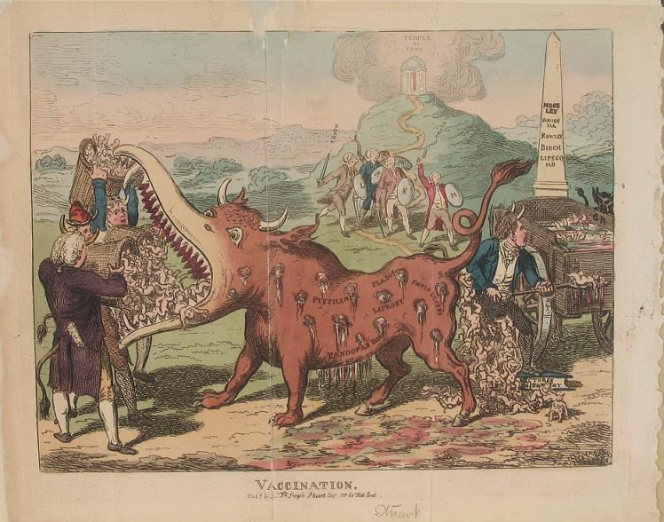
SOURCE D
“Vaccination”
Click for online zoomable version
Notes:
A monster being fed baskets of infants and excreting them with horns; symbolising vaccination and its effects (1802?) Below is a link to a really clear, zoom-able version:
wellcomelibrary.org/player/b11598803#?asi=0&ai=0&z=0.7174%2C0.0695%2C0.2009%2C0.1734

Slide 10
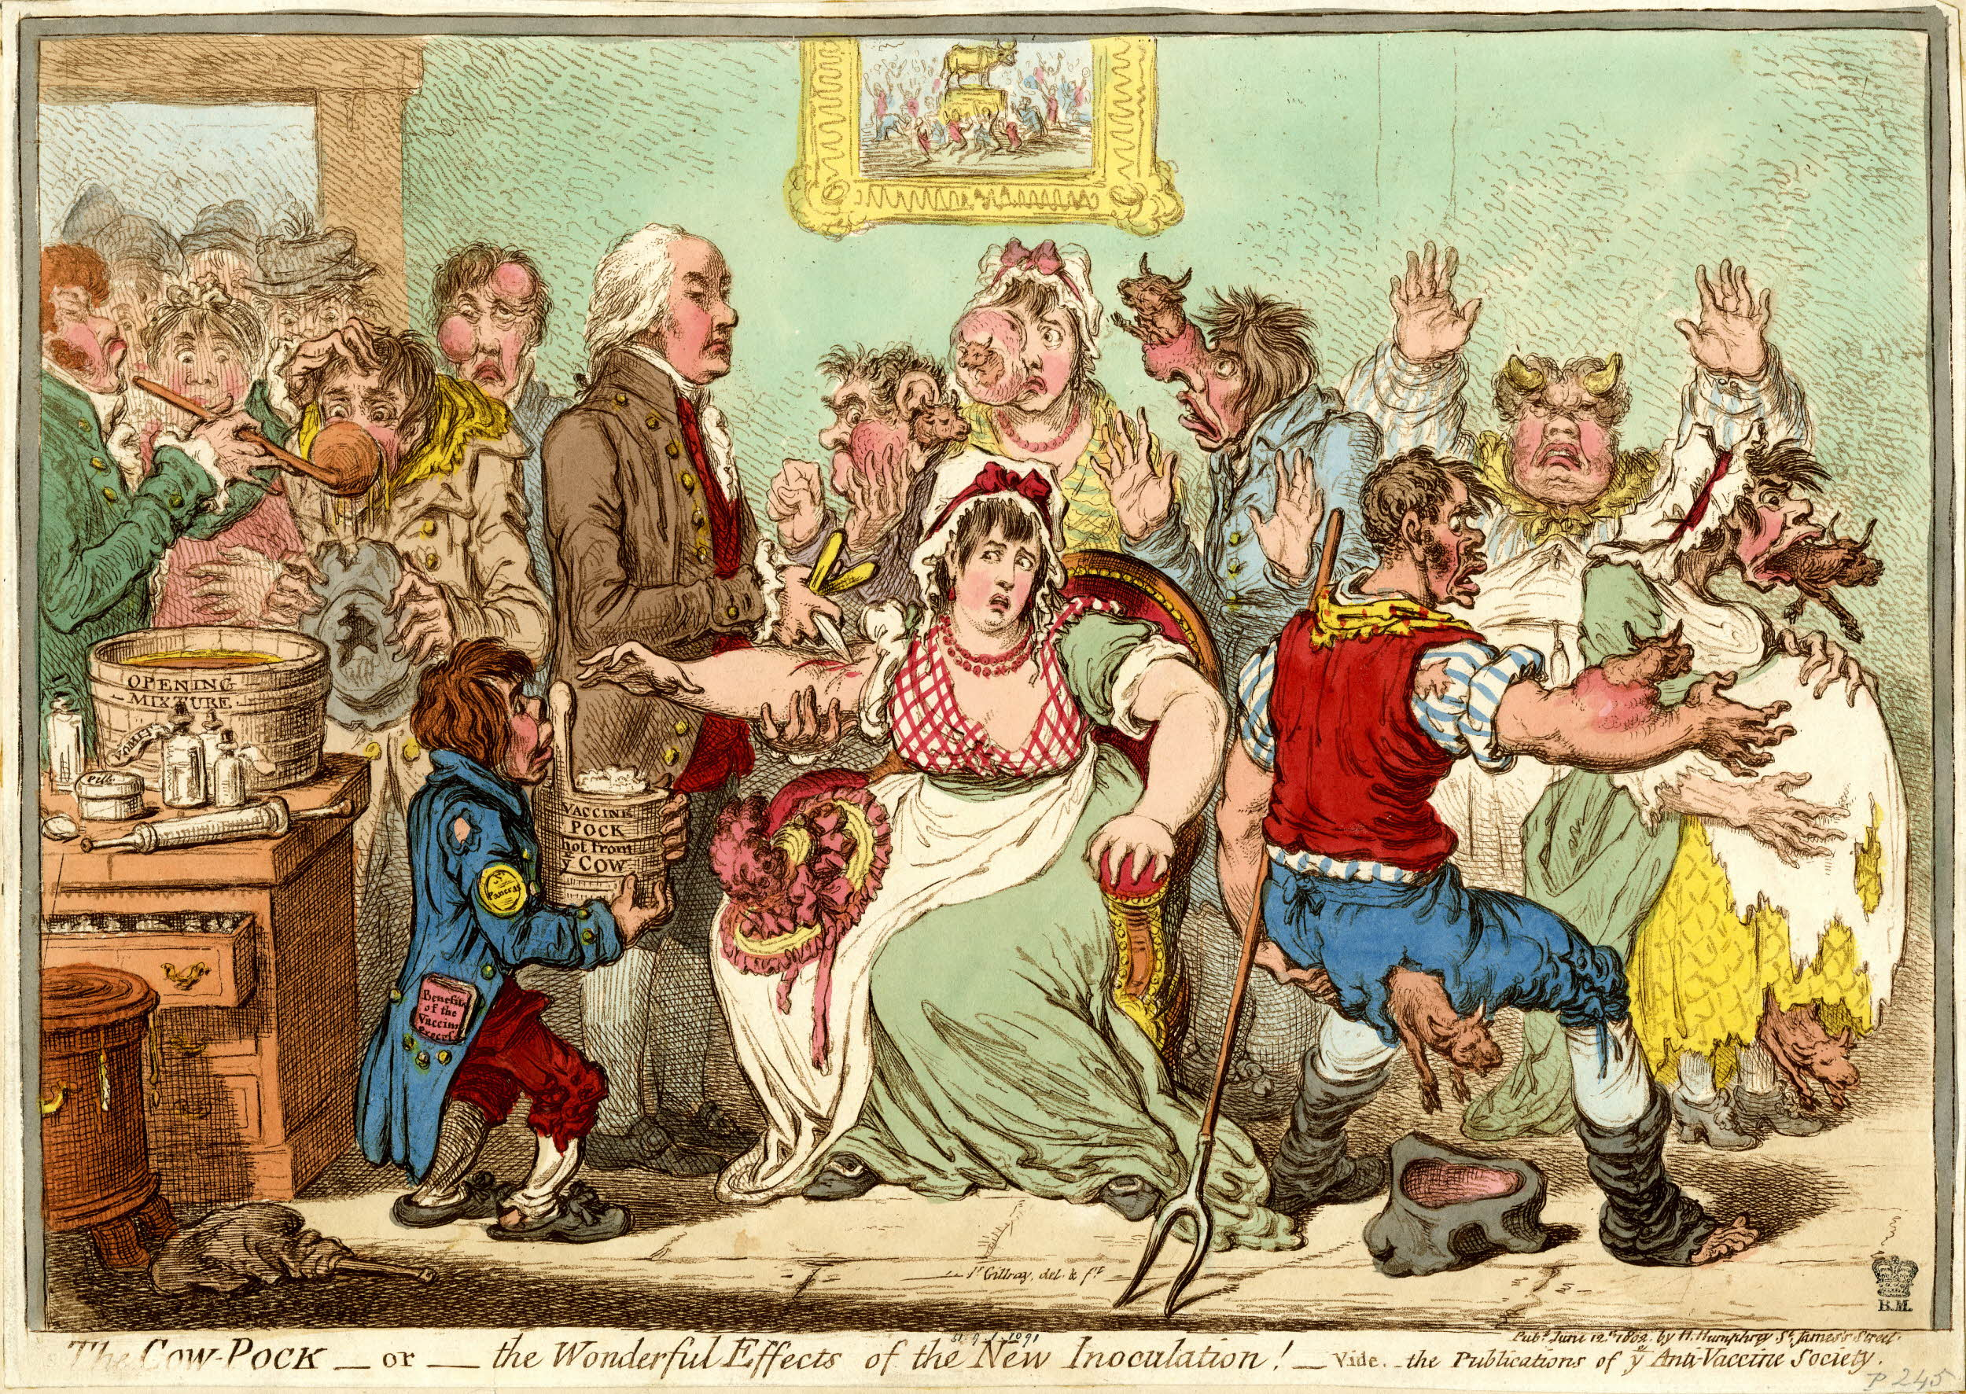
SOURCE C
The Cow-Pock – or – the Wonderful Effects of the New Inoculation!
– according to the publications of the Anti-Vaccine Society
Notes:
“The Cow-Pock – or – the Wonderful Effects of the New Inoculation! – vide the Publications of the Anti-Vaccine Society” (1802)

Slide 14
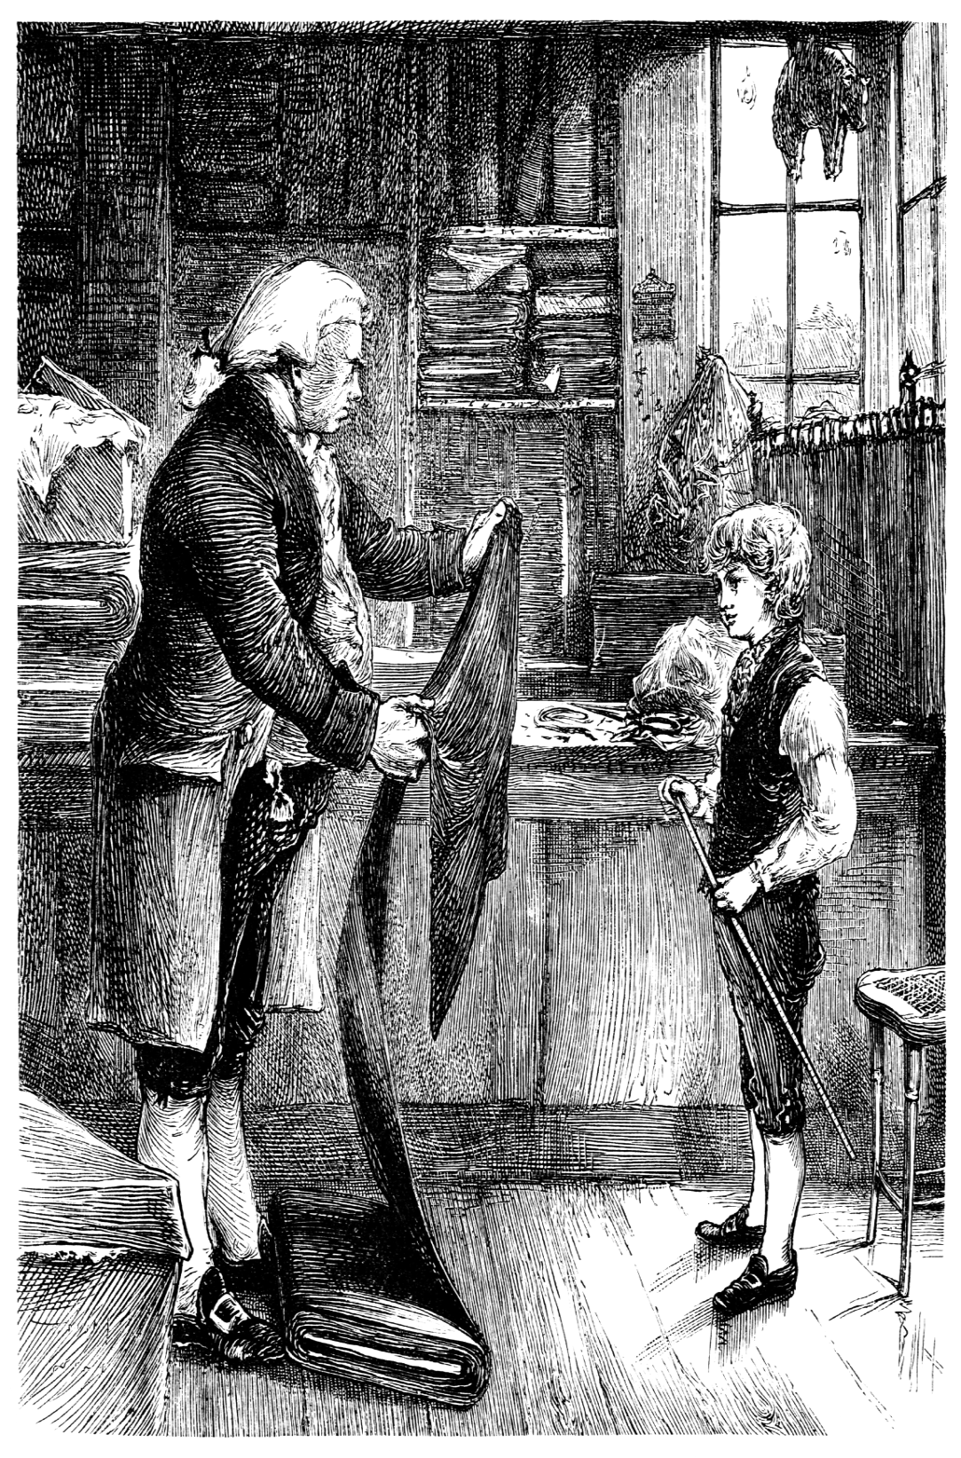
SOURCE E
Weep Jenner weep and hide your head Or blush in crimson like the Sun Visit the mansions of the dead And see the mischiefs you have done
Then view the falling pearly tear That gushes from each orphan’s eye Ask them the cause and soon you’d hear Jenner and Cow Pox they’d reply

Slide 15
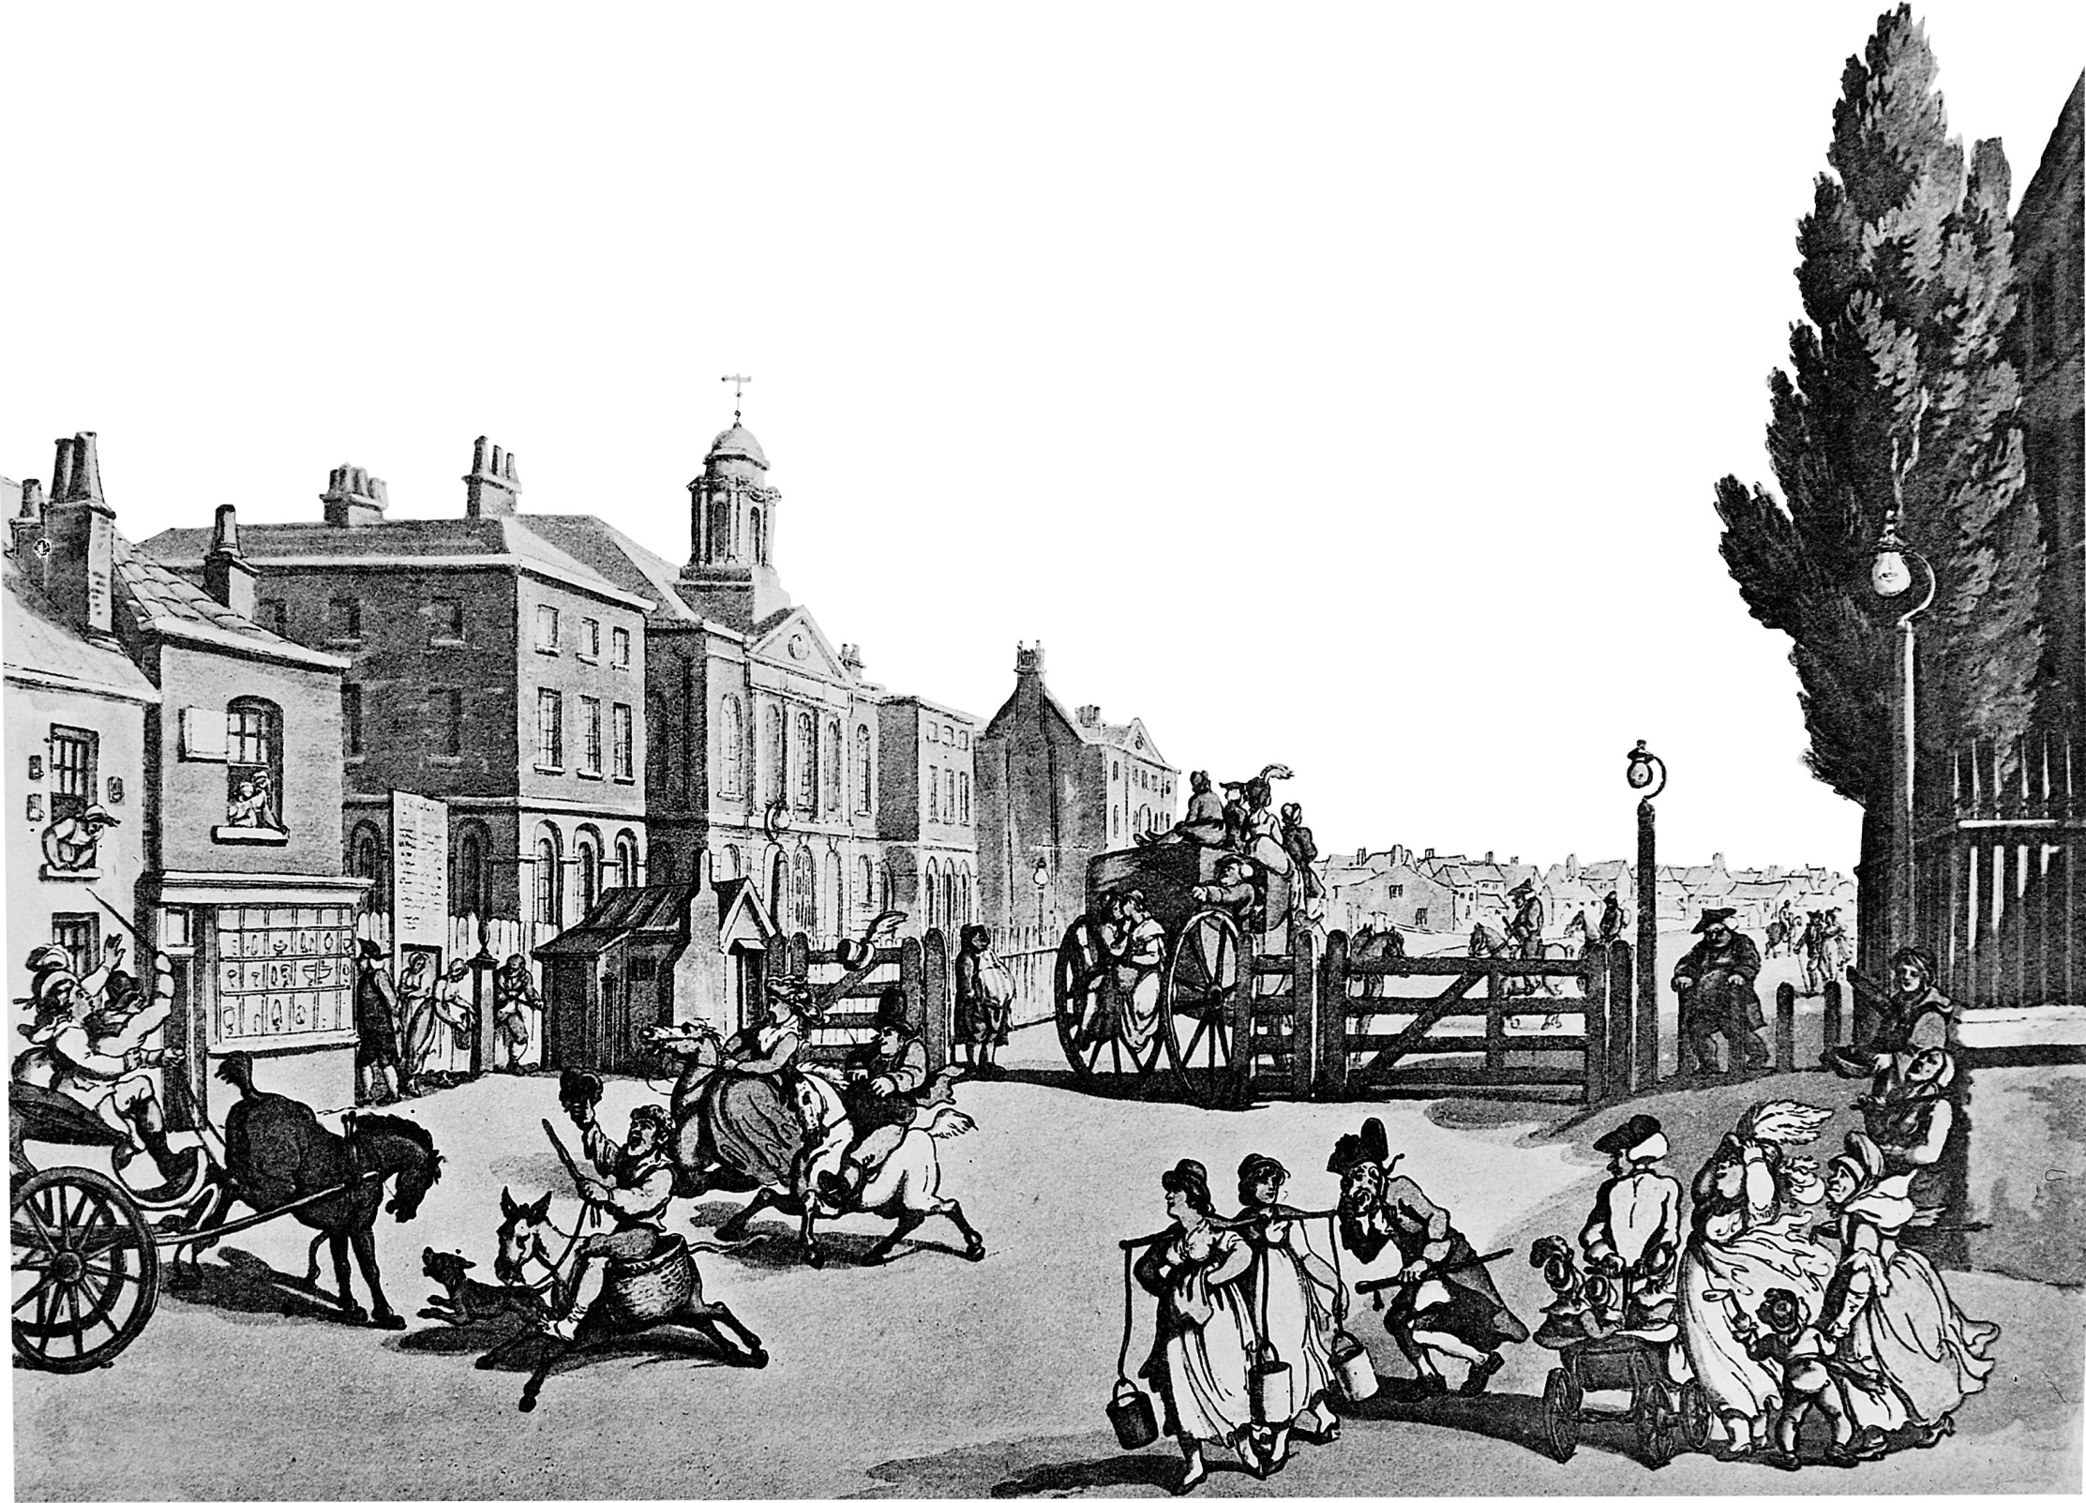
SOURCE F
“15,000 people were vaccinated in London in April 1800. We tested 5,000 of them later with smallpox pus and they showed no reaction.”

Slide 16
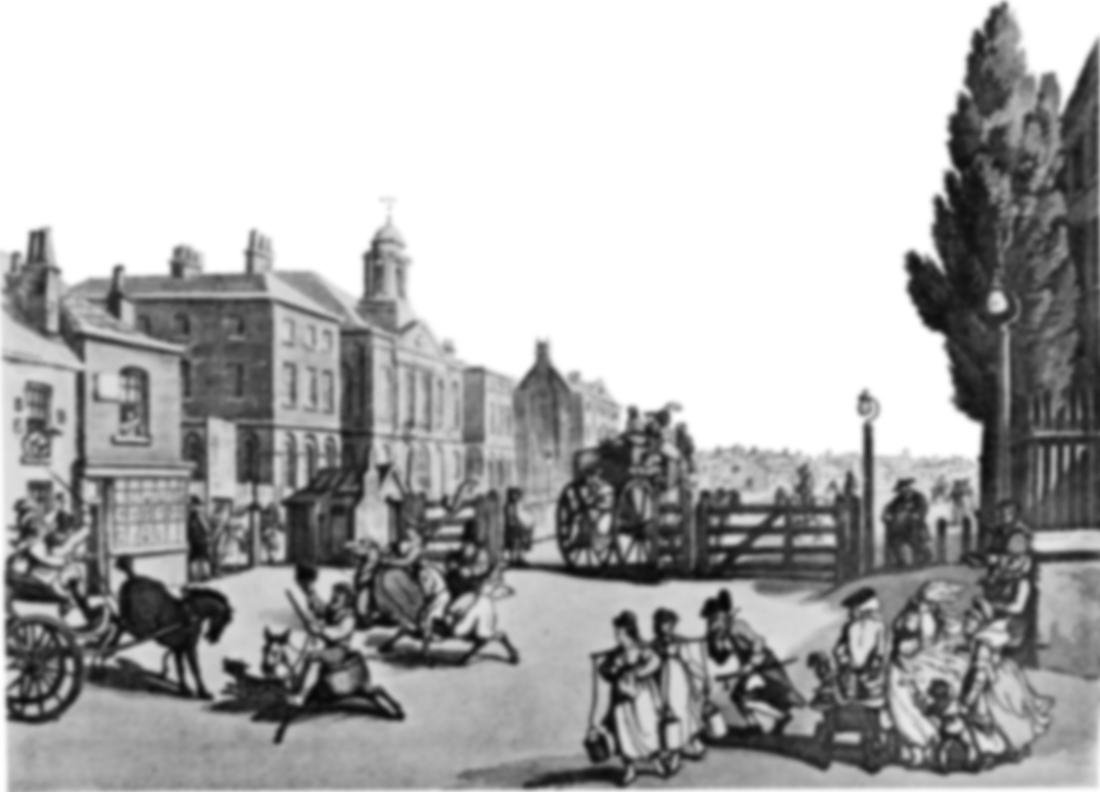
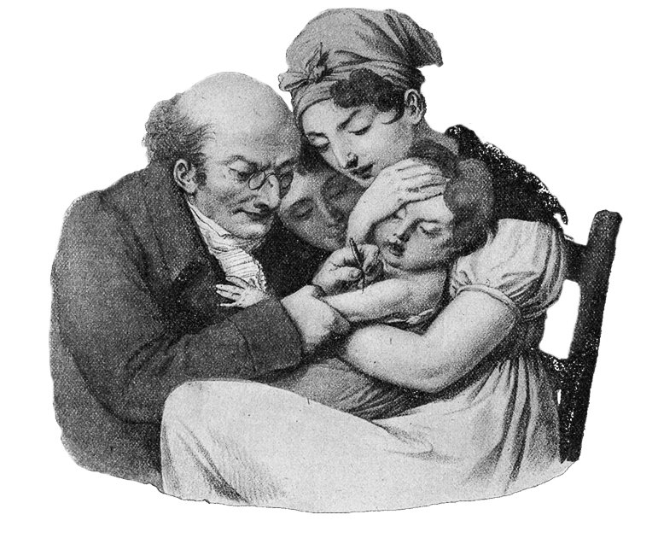
SOURCE F
“15,000 people were vaccinated in London in April 1800. We tested 5,000 of them later with smallpox pus and they showed no reaction.”
Dr Georg Balhorn

Slide 17
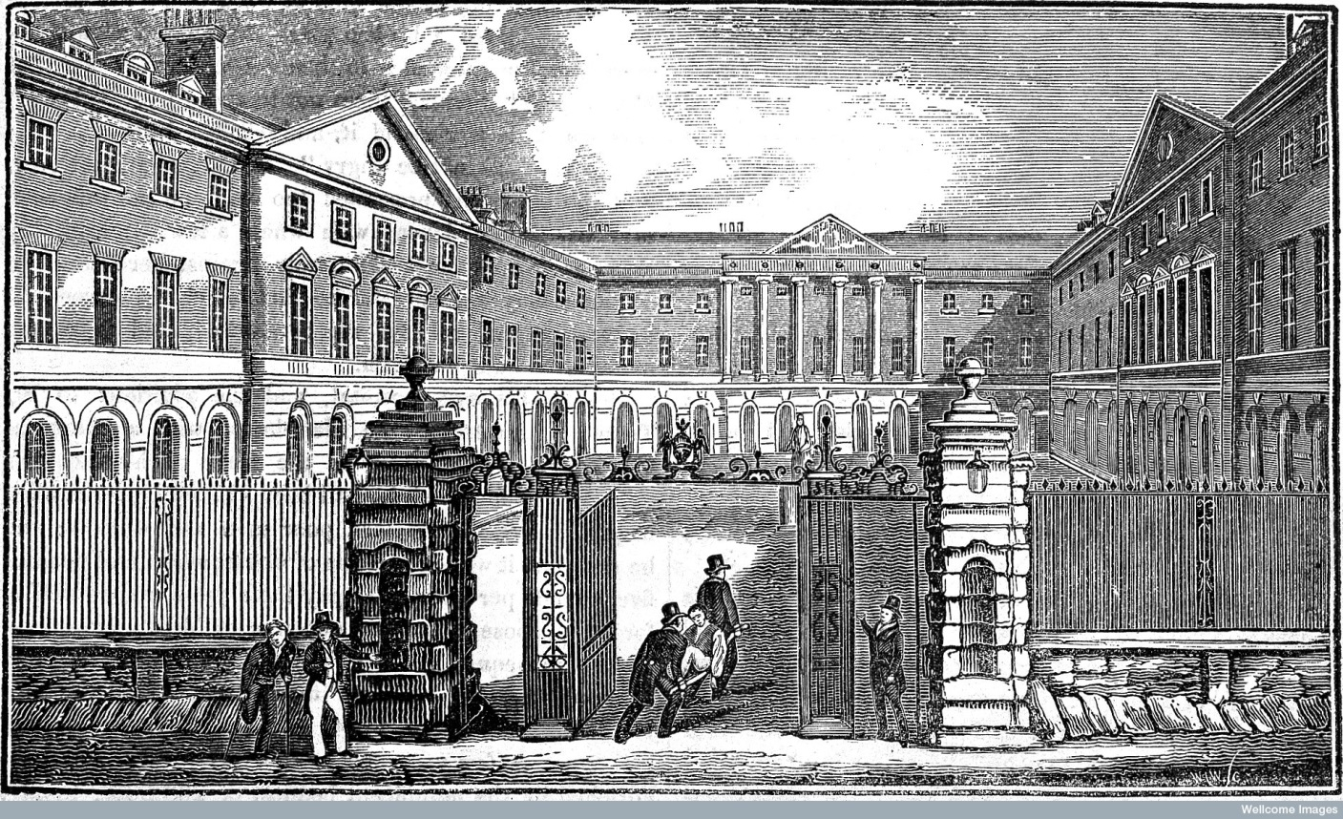
GUY’S HOSPITAL, LONDON

Slide 18
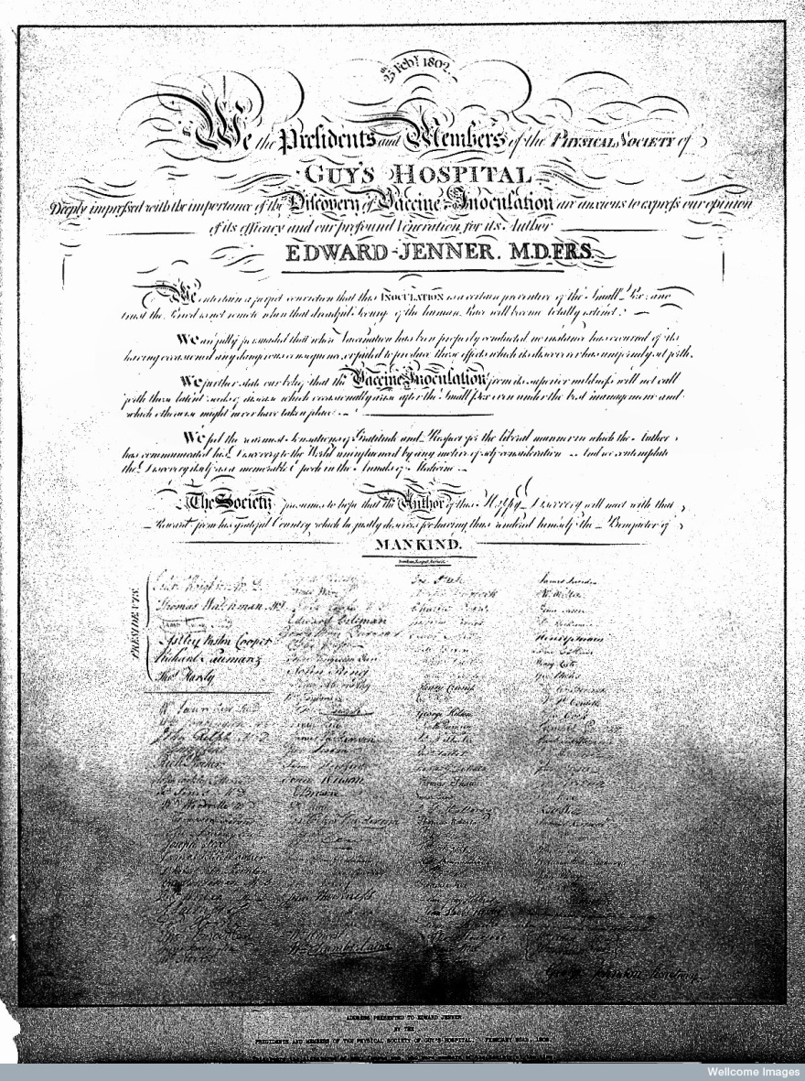
SOURCE G
“We the presidents and members of the Physical Society of Guys’ Hospital, deeply impressed by the importance of the Discovery of Vaccine Inoculation, are anxious to express our opinion of its efficacy and our profound veneration for its Author, Edward Jenner M.D.F.R.S.”
physical | = old word for medical
efficacy | = effectiveness, success
veneration | = admiration
M.D. | = Medical Doctor
F.R.S. | = Friend of the Royal Society, one of the most prestigious scientific societies in the world

Slide 19
The testimonial was signed by 112 doctors.

Slide 20
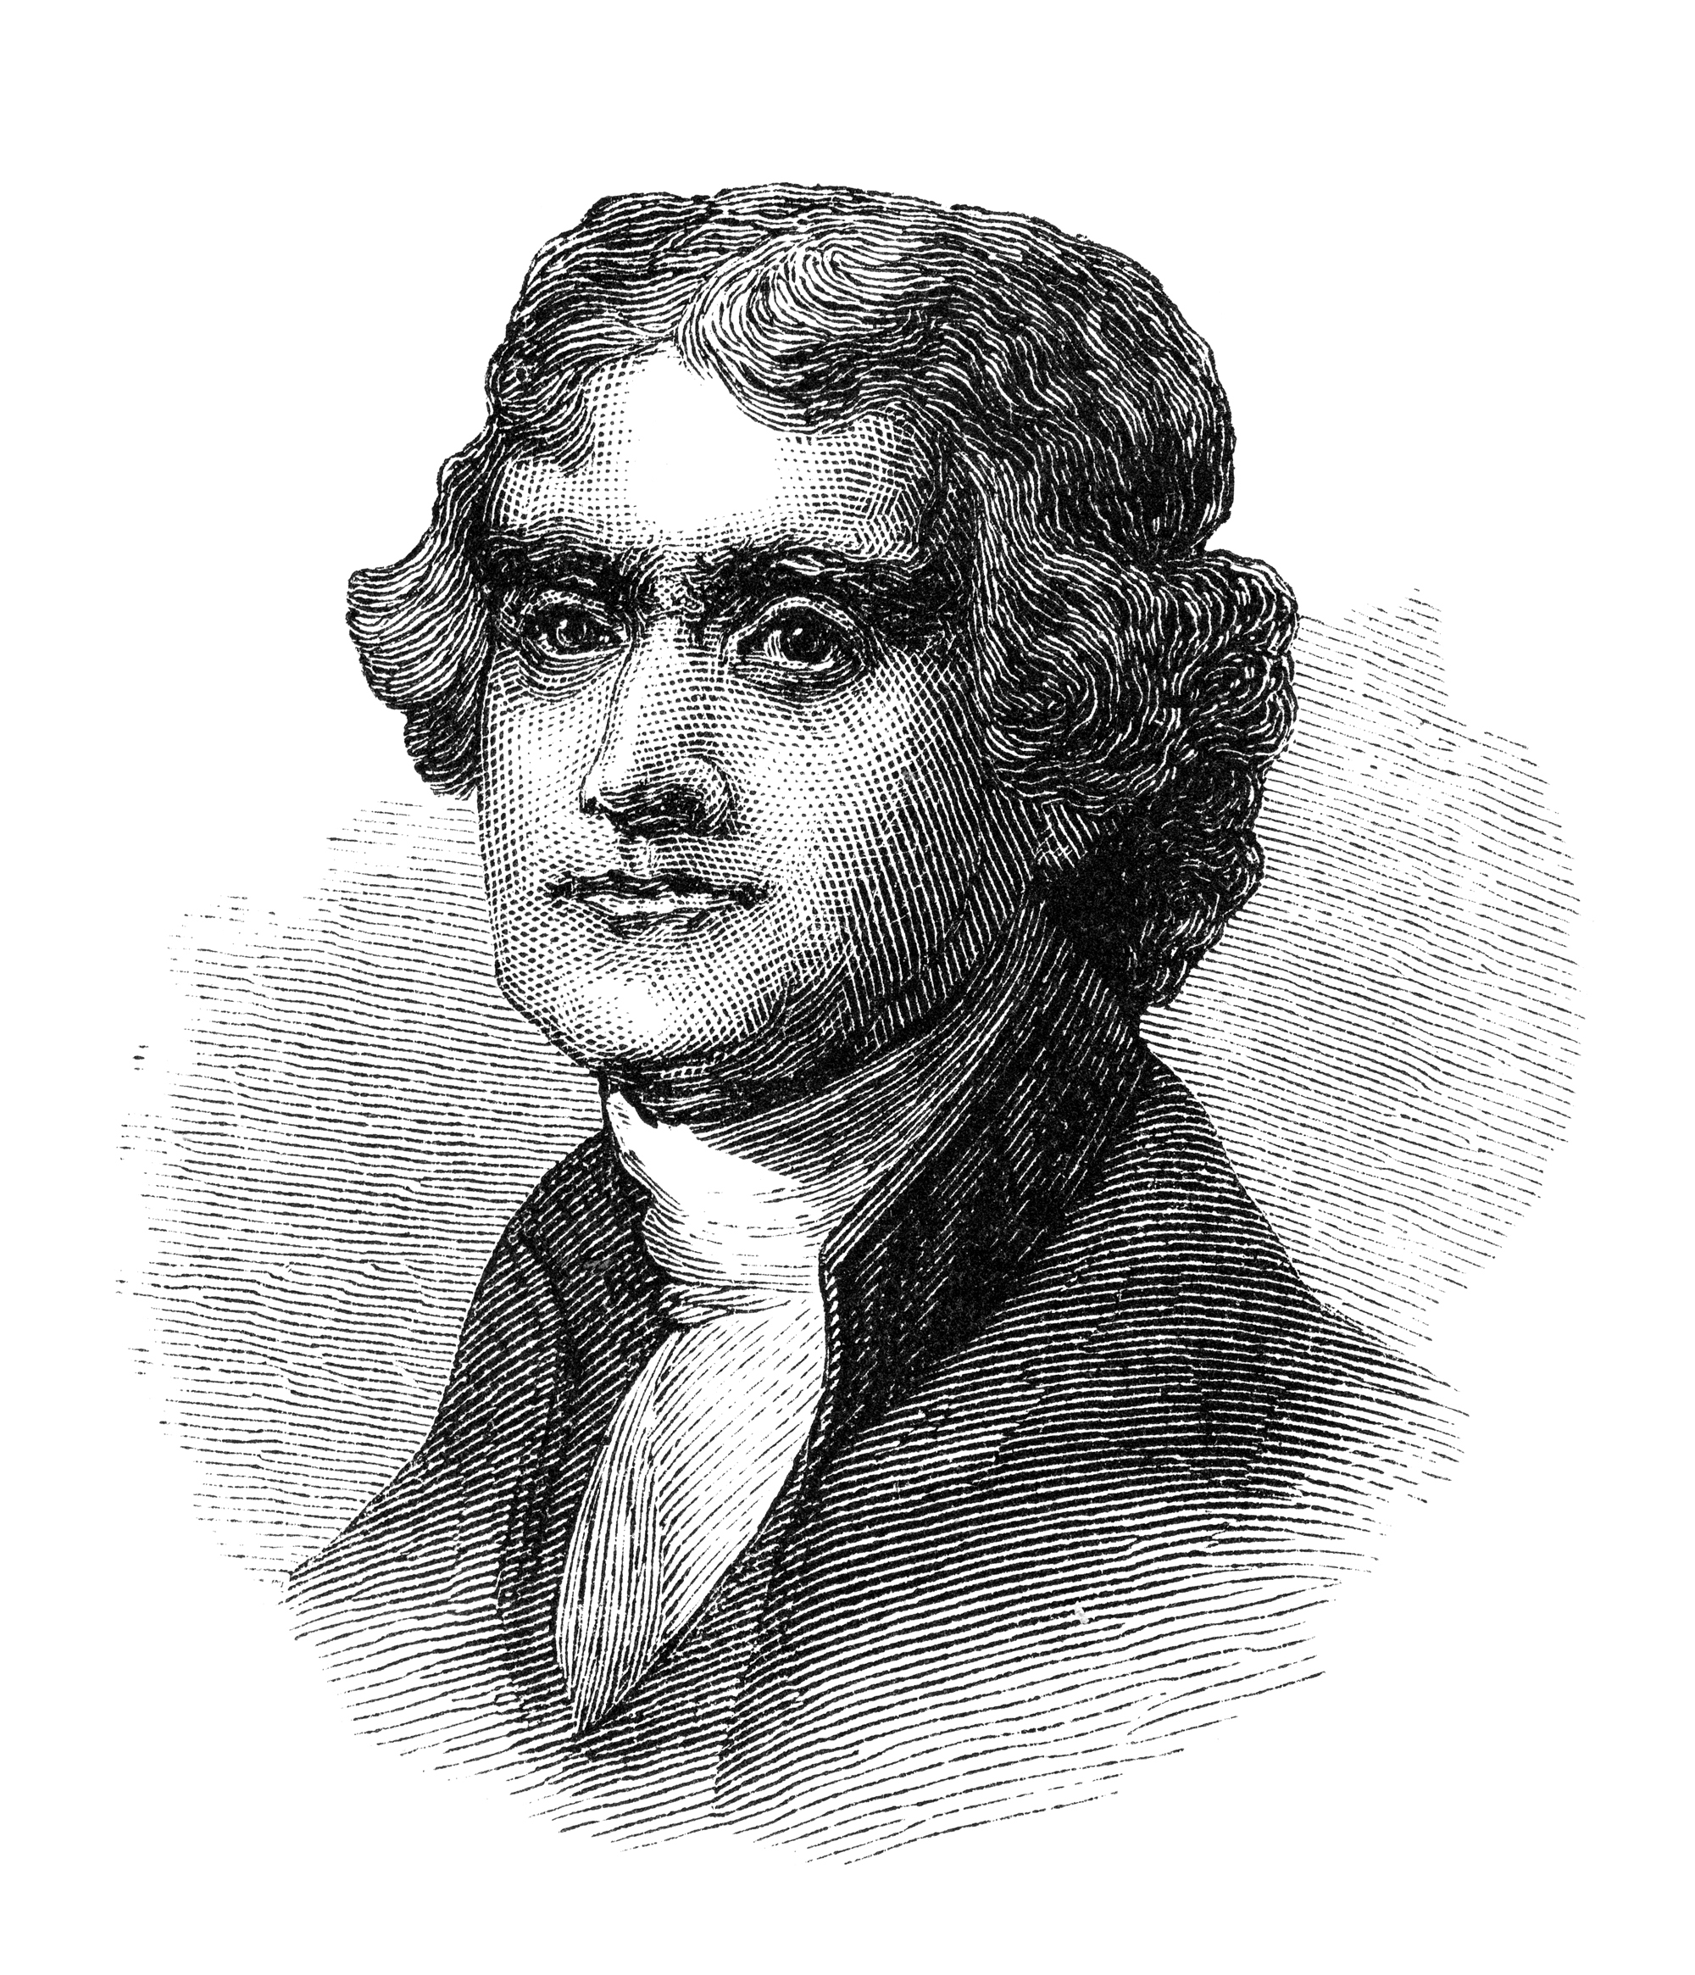
SOURCE H
“Future nations will know by history only that the loathsome smallpox has existed and by you has been extirpated.”
Thomas Jefferson, President of the United States

Slide 21
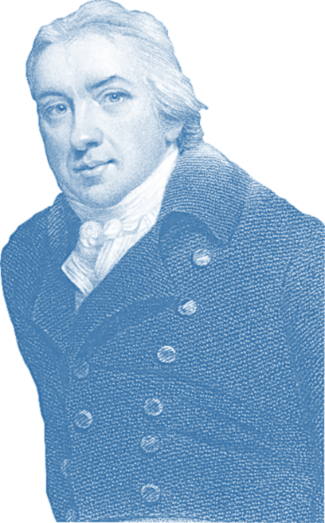
Chapter 5: Did people support Dr Jenner and vaccination in the early 1800s?
DR JENNER
B.F.G. Taylor Dr Jenner
B.F.
B.F.G. Taylor
B.F.
by B.F.G. Taylor

Slide 22
