Slide 1
18 cases
Teacher tips:
The number of new cases dips very slightly this week… does that mean the peak has been reached already?
Later in this activity children will see that even if the data goes down a bit one week, the overall trend over several weeks can still be a growth in cases.
TMF
Week 9
ENCRYPTED
Data analysts – are you updating the rest of the team with the latest figures?

Slide 2
18 cases
Teacher tips:
Allow time for pupils to complete their tasks from the Pupil Sheets then bring the class together to discuss the question of whether this could become a major outbreak.
Science advisors and data analysts should cite the significant percentage of unvaccinated people which means the community does not have herd immunity from measles. Healthcare workers can cite the fact that there is the possibility that a small number of people might die.
Then click on the video.
QUP
Week 10
ENCRYPTED
Does your research suggest that this could turn into a major outbreak? If so, click the video call button to contact Alex Phipps as soon as possible.
VIDEO CALLING ALEX PHIPPS

Slide 3
VIDEO CALL

Slide 4
Make sure children give reasons for their decisions. Make them think about the impact of their measures on people’s daily lives. For example, if you close cinemas you might have to compensate them for lost business. Who will look after the children all day if schools close? Because of their work on the Pupil Sheets, children will hopefully suggest some kind of emergency effort to vaccinate unprotected people (which is what happened in the real life situation in Swansea). But don’t prompt them yet to mention vaccination – they will have further opportunity to come to this conclusion themselves in the run up to the press conference and at the start of Episode Three.
What emergency measures should be taken to stop measles spreading?
For example…
Quarantine (isolate) brothers and sisters of infected children
Close sports centres and cinemas
Close schools and universities
Cancel concerts
Teacher tips:
Whole-class discussion about the emergency measures. The science advisors can use the information from their training in the Episode One and all children should use their understanding from the Speckled Monster activity.
If time, this could be organised as a class debate with children putting forwards different viewpoints OR you can remove the suggestions to make the children think harder. You can also suggest topical large gatherings e.g. a local football match, school disco.
Week 10
QUP
Update: the Minister has just said that you are not allowed to close any schools.
You must decide quickly! The longer you delay the bigger the risk of the outbreak escalating.
Decide now on your emergency measures.

Slide 5
12 cases
Teacher tips:
Children should realise that even if their measures work, they will probably take time to see the effect (a bit like when you give someone medicine you have to wait a few days to see if it is working).
In fact, because measles takes 7-10 days to develop after exposure (as the science advisors found out), the current week’s data actually counts how many people caught measles 7-10 days ago! (Plus maybe a couple of days before they go and see their doctor.)
ZBS
Week 11
ENCRYPTED
Data analysts – report on the latest data.
Team – how many weeks do you think you need to wait until you can start to tell if your measures are working?
So the OCT will have to wait at least two weeks to even begin to see if their emergency measures are having any effect.
Therefore you unfortunately can’t attribute the fall in cases this week to the emergency measures.

Slide 6
11 cases
Teacher tips:
No significant change this week.
EBO
Week 12
ENCRYPTED
Is the number of new cases going up or down or staying the same?

Slide 7
13 cases
There’s been a case of measles in another town and the Minister is TERRIFIED that there’s going to be another big outbreak there!
The case is a 14 year-old girl with three siblings who was sent home from school sick. She has been in contact with over a hundred people whilst contagious!!! The population of the town is 230,000 people, and 4% of them aren’t vaccinated. That’s 9,200 potential cases!
I should tell the Minister a BIG outbreak is inevitable, right?
Teacher tips:
(You can skip Alex’s email questions if you don’t have time or set them for homework.)
The question tests understanding of ‘herd immunity’.
Since 96% of people are vaccinated in the area, that is over the 95% threshold for herd immunity and it will be very difficult for measles to spread, so there probably won’t be a big outbreak in this area.
However, there is still a danger of the girl passing measles on to friends, family and other people she has had contact with if they are not vaccinated.
You might also like to ask the class how Alex arrived at his figure of 9,200 potential cases.
1% of 230,000 = 2,300
4% of 230,000 = 9,200
IYA
Week 13
ENCRYPTED
Email received from Alex Phipps. Click on the envelope to open.

Slide 8
12 cases
Teacher tips:
The number of cases seems to staying roughly the same, but below the peak of 21 new cases in Week 6.
GON
Week 14
ENCRYPTED
What are the data analysts’ graphs telling us? Is the number of cases going up, going down, or staying roughly the same?

Slide 9
21 cases
Help please! The Minister just asked me a question, and I’m not sure how to answer...
A friend of hers lives in your area, and she’s worried about their 3-yr-old daughter Matilda catching measles. But the Minister has seen that over 95% of 3 year olds are vaccinated, which means Matilda has herd immunity, right?
So can I tell her that Matilda will be fine?? Maybe I’ll say to keep her at home till the end of the outbreak to be on the absolute safe side…?
Teacher tips:
(You can skip Alex’s email questions if you don’t have time, or perhaps set them for homework.)
Another question to test understanding of ‘herd immunity’.
The concept of herd immunity applies to a whole community in a certain area, not an individual. Because the whole community doesn’t have herd immunity, measles can spread through it easily.
Pupils should also realise that the most important question is whether Matilda herself is vaccinated or not.
LDM
Week 15
ENCRYPTED
Email received from Alex Phipps. Click on the envelope to open.
That is the only way to guarantee protection from measles.
It’s not much good keeping Matilda at home if her mother can catch measles and pass it on to her. And anyway, could she really keep her daughter locked indoors for the whole outbreak? What if it lasts a whole year?!
Did the data analysts point out the worrying jump from 12 to 21 new cases this week – the biggest increase yet…?

Slide 10
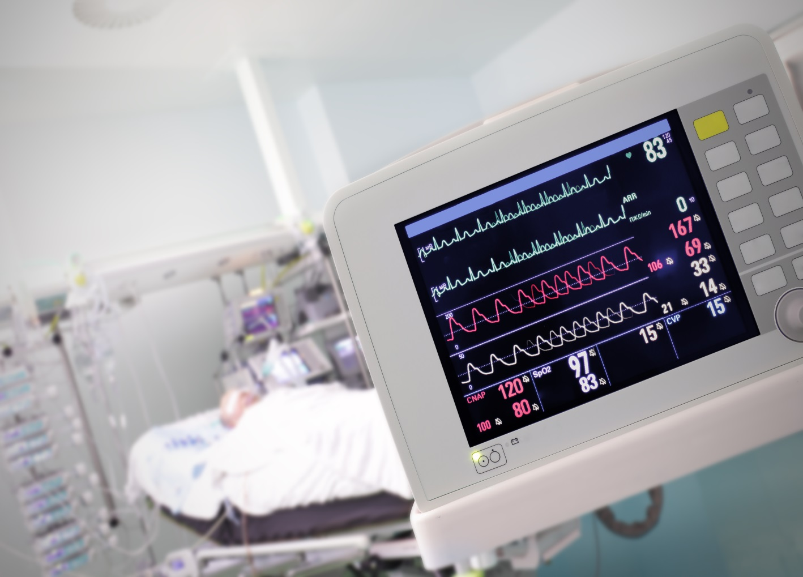
19 cases
Teacher tips:
The number of cases has stayed almost exactly the same this week.
QBR
Week 16
ENCRYPTED
There was a worrying increase in cases last week. Have cases gone up again this week? Do we need to take any further emergency measures?
Local media are reporting that a patient has died of measles…
NEWS FLASH

Slide 11
Week 16
INCOMING VIDEO CALL

Slide 12
VIDEO CALL

Slide 13
Teacher tips: Provide each team with a copy of PS4 containing three key questions from journalists. You may wish to collect suggestions for other questions from the class and add these to the table on PS4, or add your own.
You could also rearrange the classroom to imitate a press conference setting and play the video on the next slide on the whiteboard.
See notes on PS4 PowerPoint for extra details.
Week 16
QOR
The press conference will start shortly. Make sure you are prepared!
Thousands of worried people will be watching!

Slide 14
Teacher tips: Provide each team with a copy of PS4 containing 3 key questions from journalists. You may wish to collect suggestions for other questions from the class and add these to the table on SS4.
You could also rearrange the classroom to imitate a press conference setting.

Slide 15
This activity was produced by the Association for Science Education
in partnership with James Films © 2016
Promoting Excellence in Science Teaching and Learning

