Slide 1
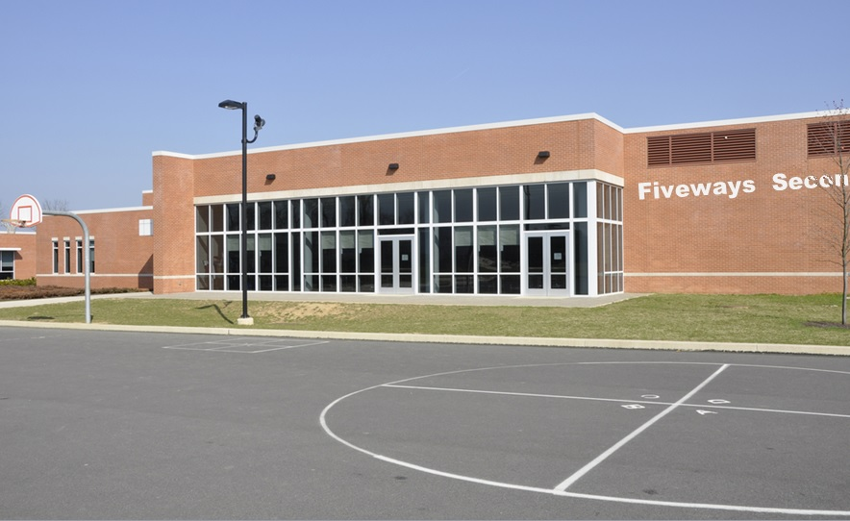
6 cases
Teacher tips: You might like to ask children why a disease might spread easily in a school. (Lots of children from the local area all mixing together in the same place confined space).
Week 3
Six new cases reported this week – all of which were children.
or Fiveways Secondary school.
Again, the new cases were children attending either Parkfield Primary School
What do you predict will happen next week?
INCOMING VIDEO CALL

Slide 2
VIDEO CALL

Slide 3
Teacher tips:
Hand out the Pupil Sheets now.
Week 3
Start your training now!

