Slide 1
Look out for the Teacher Tips to the left of the PowerPoint when in NORMAL VIEW. The presentation must be played in READING VIEW or SLIDE SHOW VIEW.
You can switch between views by using the toggle buttons at the bottom of the screen:
Teacher tips:
You control the pace of the activity by advancing the slides.
But sometimes you might be interrupted by an urgent message!
Please be patient with the slides –
they will take a few seconds to advance and load…

Slide 2
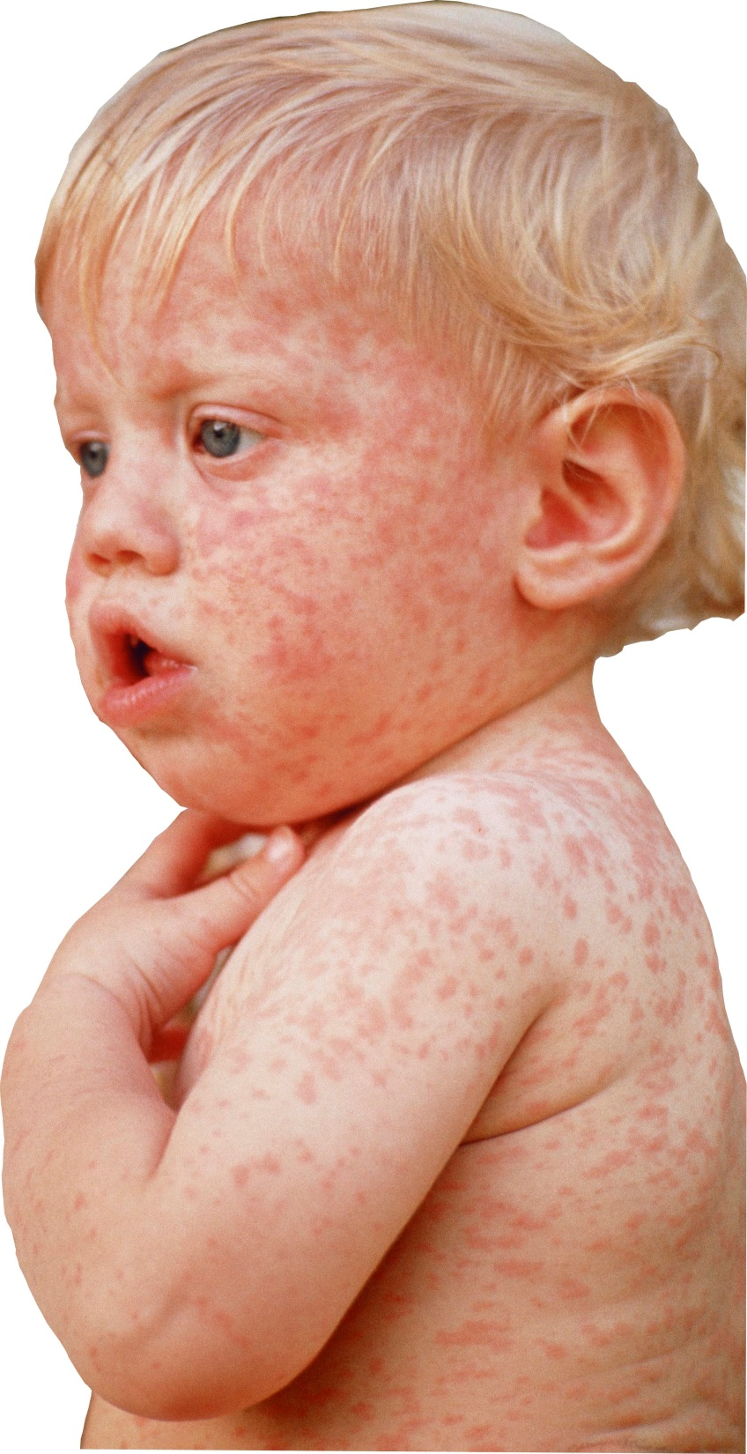
Teacher tips:
Play this presentation in the background before the start of the activity, with the music playing, to create atmosphere. See if children notice what is slowly happening to the words (they are becoming infected with measles!).
EPISODE ONE

Slide 3
Connecting to Ministry of Health user interface… Please wait…

Slide 4
Ministry of Health

Slide 5
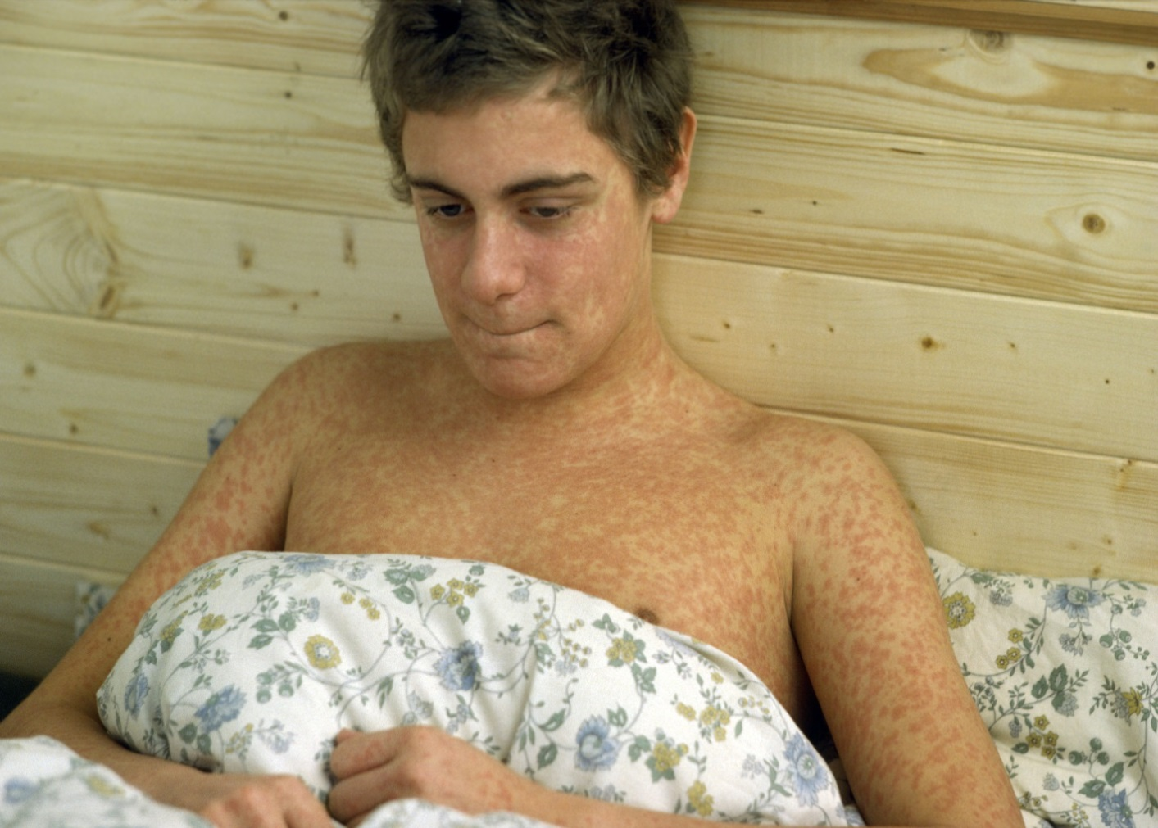
2 cases
Teacher tips:
You will usually need to advance the action in the slides manually.
Week 1
Two local doctors have reported patients with measles in one week.
ALERT!

Slide 6
2 cases
Teacher tips:
Throughout this activity children should always be trying to predict what is going to happen next, based on their knowledge and the data and graphs they have.
It is likely that the next cases will occur in the same schools or in the families of the children who have measles.
Week 2
Will more cases occur? If so, where do you predict they will occur?
Doctors have reported two new cases. Questionnaires are being sent to the parents of all infected children to gather more information.
However, we do know that the confirmed cases are all children who attend either Parkfield Primary School or Fiveways Secondary School.

Slide 7
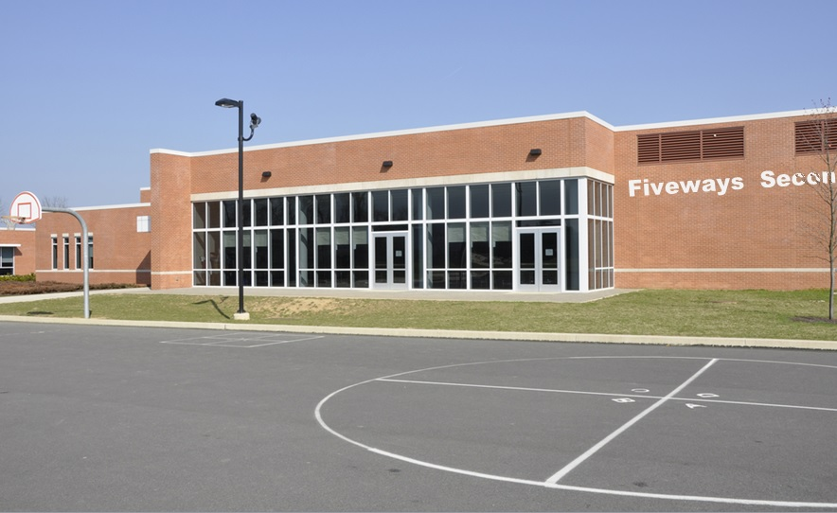
6 cases
Teacher tips: You might like to ask children why a disease might spread easily in a school. (Lots of children from the local area all mixing together in the same place confined space).
Week 3
Six new cases reported this week – all of which were children.
or Fiveways Secondary school.
Again, the new cases were children attending either Parkfield Primary School
What do you predict will happen next week?
INCOMING VIDEO CALL

Slide 8
VIDEO CALL

Slide 9
Teacher tips:
Hand out the Pupil Sheets now.
Week 3
Start your training now!

