Slide 1
DSN
Week 34
ENCRYPTED
Data analysts – share the latest figures with the team…
INCOMING VIDEO CALL

Slide 2
VIDEO CALL

Slide 3
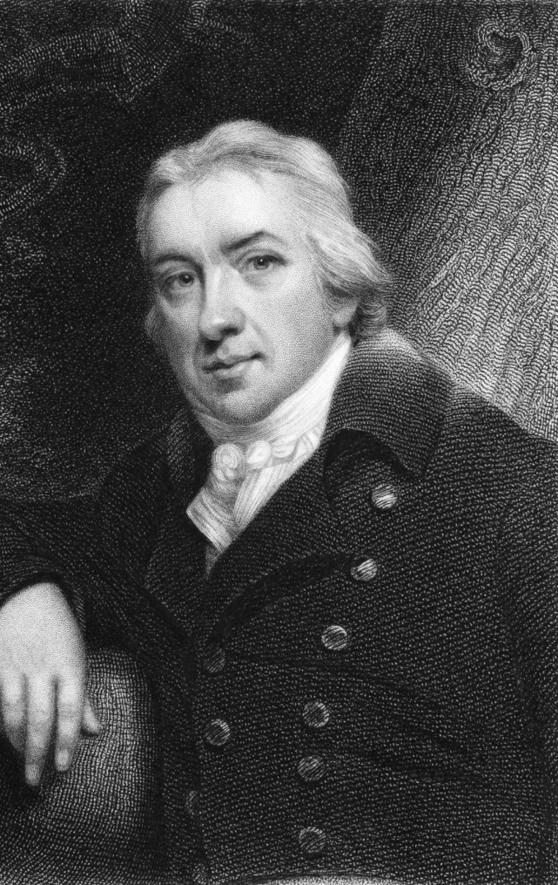
22 cases
All Clear request sent for authorisation…
Request denied !
22 cases reported this week.
You MUST NOT misinform the public. You have been fined a week’s wages for dangerous conduct.
Do you know who this guy is?? Why did she kiss his picture?!!
And she just sent me another picture of some little boy and wrote “Any relation?”
Do you know what she’s on about? I think the pressure of the job has finally got to her!
Teacher tips:
Week 34
!
Press the green button to issue the All Clear when it’s time.

Slide 4
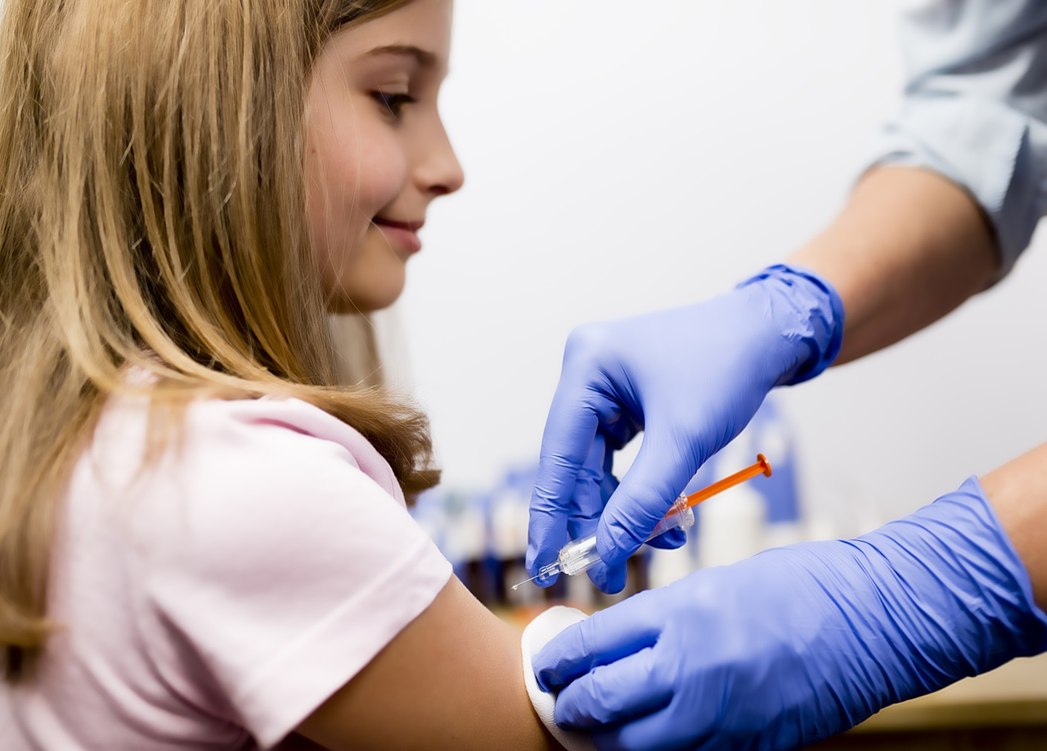
2 cases
All Clear request sent for authorisation…
Request denied !
2 cases reported this week.
You MUST NOT misinform the public .
Remember, it takes just ONE case of measles to start an outbreak. You have been fined a week’s wages for dangerous conduct.
WLS
Week 35
ENCRYPTED
!
This girl, Zoe, aged 9, has written you a letter thanking you for helping to get her vaccinated and protecting her from measles.

