Slide 1
Look out for the Teacher Tips to the left of the PowerPoint when in normal view.
Teacher tips:
Please be patient with the slides –
they will take a few seconds to advance and load…

Slide 2
Connecting to Department of Health user interface… Please wait…

Slide 3
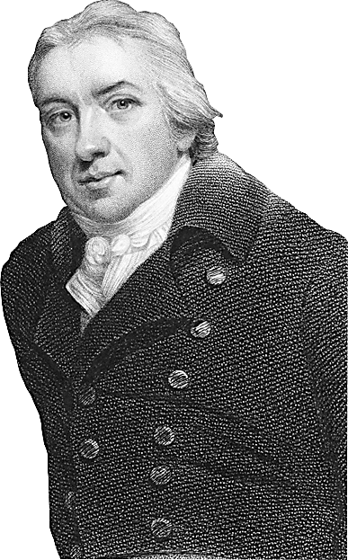
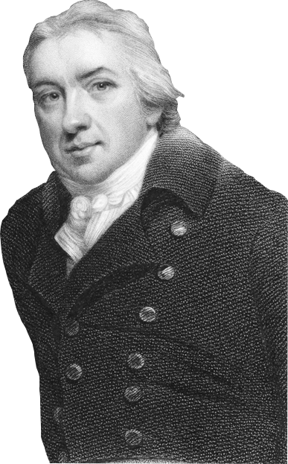
Teacher tips:
During this intro, the figure of Dr Jenner will slowly appear… see who is the first in the class to work out who it is!
If children don’t immediately understand the connection between Jenner and this ‘modern’ activity, you can return to this theme at the end of the activity and discuss it…
EPISODE FOUR

Slide 4
163 cases
Teacher tips:
Some children might have thought that because the figures had started to drop that the outbreak had reached the peak and the number of cases would continue to decrease…
However, they can see from the data analysts’ graphs that the data can go down a bit from one week to the next even when the overall trend is that the data is rising (for example this happened on Week 27).
Teacher tips:
Children compare their predictions from the end of the last episode.
UV#
Week 26
ENCRYPTED
Data analysts – report the latest figures to the rest of the team. Who was closest with their prediction?
INCOMING VIDEO CALL

Slide 5
VIDEO CALL

Slide 6
Teacher tips:
Quick whole-class discussion for suggestions.
The key reason is that there has not been enough time for the vaccination campaign to take effect. Hopefully in the next few weeks, the figures will start to drop.
Children can also restate ideas from previous episodes, e.g. vaccination gives you immunity; there is a risk of complications or deaths from measles and the Minister will be responsible for these; if we achieve 95% vaccination then the community will have herd immunity and the outbreak should stop…
You might like to pick a child from the class to write a quick ‘email’ to the Minister.
(You might also like to point out that the Minister was wrong when she said that this was the biggest increase yet. 163 is the biggest number yet, but the increase from last week was only 27. Challenge the data analysts to spot the week that saw the biggest increase. This was Week 21, when the figures when up by 52 – which means the outbreak was growing fastest at this point, almost twice as fast as this week. )
UV#
Week 26
What can you tell the Minister to convince her to keep going with the vaccination campaign?! You need to email Alex back ASAP – click on the send mail button when you’re ready.

Slide 7
Good work team!
The Minister has agreed to give us TWO more weeks to see if the vaccination programme will work…
I really hope the figures go down…
For everyone’s sake!!!!!!!!!!!
Teacher tips:
Alex’s reply will come automatically after about 20 seconds…
UV#
Week 26
Email sent. Waiting for reply…
What will you do if the Minister still refuses?
Email received from Alex Phipps. Click on the envelope to open.

Slide 8
91 cases
Teacher tips:
This is a huge drop from last weeks, back to under a 100 cases a week.
ZRO
Week 27
ENCRYPTED
Data analysts – report the latest figures to the rest of the team.
Discuss together.

Slide 9
50 cases
Teacher tips: Another considerable drop in cases.
The data analysts’ graphs should show a very steep downward slope on the ‘hill’, suggesting that the outbreak is dying down.
LHE
Week 28
ENCRYPTED
What are the latest figures? What pattern can you see in the data analysts’ graphs? Does the vaccination campaign seem to be working?

Slide 10
I’ve just shown the Minister your graphs and she’s agreed to continue the vaccination programme indefinitely! She’s also calling off the Red Alert. Well done!
But there were still 50 new cases this week…
The Minister wants the outbreak declared over within two months! Do you think we’ll do it??!
Week 28
Email received from Alex Phipps. Click on the envelope to open.

Slide 11
55 cases
(More able children can try this without a calculator)
30,000 ÷ 80,000
= 30 ÷ 80
= $\frac{30}{80}$
= $\frac{3}{8}$
(which is under a half)
= 0.375
≈ 0.38
= 38%
Alternative method:
50% of 80,000
= 40,000
So 30,000 is less than 50%.
Team, can you help me with a tricky question?
I have some data in from your vaccination programme. So far almost 30,000 children have been immunised against measles as a direct result of your campaign. Outstanding work!
If there were about 80,000 unvaccinated children in your area at the start of the outbreak, what percentage of these children have we vaccinated so far?
The Minister has set a target of over 50%. Have we reached it??
Teacher tips:
(You can skip Alex’s maths problems if you don’t have time, or set them for homework)
The number of cases has risen slightly, but children should know now that these little fluctuations do not necessarily reflect the bigger trend shown on the measles cases line graph.
GHH
Week 29
ENCRYPTED
Email received from Alex Phipps. Click on the envelope to open.

Slide 12
42 cases
Teacher tips:
(You can skip out these mini discussion questions if you don’t have time.)
The data analysts’ graphs are showing a rapid decline in weekly cases, which children should recognise from the Speckled Monster activity means that the outbreak is probably nearing an end. A slight ‘bump’ in last week’s figures does not change this overall , long-term trend.
TKS
Week 30
ENCRYPTED
There was a rise in cases last week. Local media and parents are concerned that this means the outbreak is about to spiral up again. What will you tell them?

Slide 13
23 cases
QN#
Week 31
ENCRYPTED
Continue to monitor the data closely…

Slide 14
30 cases
Teacher tips:
This video does not show the boy actually getting vaccinated, but nevertheless please be aware of any sensitive children in your class.
GAD
Week 32
ENCRYPTED
The success of the vaccination clinics has been incredible… almost 40,000 children have been vaccinated… and counting!

Slide 15
19 cases
Over 50,000 children have now been immunised against measles thanks to your campaign! An outstanding achievement!
But have we reached the Minister’s target?? (Remember, we started with 80,000 unvaccinated children in your area, and she wants us to vaccinate 50% of these).
Secondly, a REALLY challenging question! If there are 680,000 children altogether in your area, what percentage is left who are still NOT vaccinated? Based on your answer, is your area at risk of future outbreaks?
Teacher tips:
First part:
50,000 ÷ 80,000
=$\frac{5}{8}$
Which is over half.
= 0.625
= 63% (rounded up)
Alternate method:
50% of 80,000 = 40,000
So 50,000 is bigger than 50%
Second part (a challenging multi-step problem for the most able pupils to attempt):
80,000 – 50,000 = 30,000 children still unvaccinated 30,000 ÷ 680,000
=$\frac{3}{68}$
≈ 0.0441 (using calculator)
= 4.4 % (rounded up)
That bodes well for the future, as this generation should now have herd immunity!
GBR
Week 33
ENCRYPTED
Email received from Alex Phipps. Click on the envelope to open.

