Slide 1
The Great Vaccine Debate – Evidence Sheet 1
Source |  | For or against? | Evidence to help B.F.G Taylor answer ‘Did people support Dr Jenner and vaccination in the early 1800s?’ | Evidence to help MPs answer ‘Does vaccination work and is it safe?’ What questions could you ask the person to challenge their evidence?
A | Dr Benjamin Moseley |  | Some doctors expressed concerns about the effects vaccination would have on the human body. | No one can predict the effects vaccination will have on the human body. What about Dr Jenner’s experiments?
 | Doctor
B | Dr William Rowley |  | Some doctors wrote articles against vaccination. For example, Dr Rowley said vaccination had turned one boy into an ox. | Dr Rowley claims to have seen over 500 cases where vaccination hasn’t worked. Vaccination might turn you into…
 | Doctor
C | Charles Williams |  | The cartoonist Charles Williams portrayed Dr Jenner as a devil. | Vaccination is a Pandora’s Box. It will… There are some doctors who think vaccination is dangerous, including…
 | Cartoonist
D | James Gillray |  | The cartoonist James Gillray made fun of… | The fears about people turning into animals are silly and unscientific. It’s just a cartoon. It gives an opinion without any facts or evidence.
 | Cartoonist

Slide 2
The Great Vaccine Debate – Evidence Sheet 2
Source |  | For or against? | Evidence to help B.F.G Taylor answer ‘Did people support Dr Jenner and vaccination in the early 1800s?’ | Evidence to help MPs answer ‘Does vaccination work and is it safe?’ What questions could you ask the person to challenge the evidence?
E | William Howard |  | Some people blamed Dr Jenner for the deaths of their family. For example… | Vaccination doesn’t work and gives people false security. Vaccination is a killer! Were William’s family vaccinated properly? This is just one family. How many other people who have been vaccinated have gone on to catch smallpox?
 | Tailor
G | Signed by 112 doctors |  | Many doctors supported Dr Jenner and vaccination. For example… | All the doctors at Guy’s Hospital in London believe vaccination works and is safe. How many people have they actually vaccinated and tested?
 | Doctors
F | Dr Georg Balhorn |  | Thousands of people got themselves vaccinated, so they must have thought it was a good idea. | There is lots of evidence that vaccination works. For example…
 | Doctor
H | Thomas Jefferson |  | The President of the United States supported vaccination and recommended it to the American people. | The President of the United States predicts that…
 | President of USA

Slide 3
The Great Vaccine Debate – Evidence Sheet 1
Source |  | For or against? | Evidence to help B.F.G Taylor answer ‘Did people support Dr Jenner and vaccination in the early 1800s?’ | Evidence to help MPs answer ‘Does vaccination work and is it safe?’ What questions could you ask the person to challenge their evidence?
A | Dr Benjamin Moseley | Against | Some doctors expressed concerns about the effects of vaccination on the human body. | No one can predict the effects that vaccination will have on the human body. What about Dr Jenner’s experiments?
 | Doctor
B | Dr William Rowley | Against | Some doctors wrote articles against vaccination. For example, Dr Rowley said vaccination had turned one boy into an ox. | Vaccination might turn you into an ox! Dr Rowley claims to have seen over 500 cases where vaccination didn’t work or gave people horrible diseases. Is it a fact that vaccination did this to the boy? Did Dr Rowley exaggerate the picture or even make it up? Do all of his ‘500 proofs’ really exist?
 | Doctor
C | Charles Williams | Against | The cartoonist Charles Williams portrayed Dr Jenner as a devil. | Vaccination is a “Pandora’s Box”. It will kill people and give them new diseases rather than saving people from smallpox. There are some doctors who think vaccination is dangerous. These include doctors opposed Dr Jenner, led by Dr Mosely, Dr Squirrill, Dr Rowley, Dr Birch and Dr Lipscomb. It’s just a cartoon. It exaggerates for effect.
 | Cartoonist
D | James Gillray | For | The cartoonist James Gillary made fun of people who thought vaccination might turn people into animals. | The fears about people turning into animals are silly and unscientific. It’s just a cartoon. It gives an opinion without any facts or evidence.
 | Cartoonist

Slide 4
The Great Vaccine Debate – Evidence Sheet 2
Source |  | For or against? | Evidence to help B.F.G Taylor answer ‘Did people support Dr Jenner and vaccination in the early 1800s?’ | Evidence to help MPs answer ‘Does vaccination work and is it safe?’ What questions could you ask the person to challenge their evidence?
E | William Howard | Against | Some people blamed Dr Jenner for the deaths of their family. For example, a tailor whose wife died of smallpox wrote a poem about Dr Jenner saying that he should be deeply ashamed of himself. | Vaccination doesn’t work and gives people false security. Vaccination is a killer! Were William’s family vaccinated properly? This is just one family. Have many other people who have been vaccinated have gone on to catch smallpox?
 | Tailor
G | Signed by 112 doctors | For | Many doctors supported Dr Jenner and vaccination. For example, 112 doctors at Guy’s Hospital signed a testimonial thanking him for his discovery. | All the doctors of Guy’s Hospital believe vaccination works and is safe. How many people have they actually vaccinated and tested?
 | Doctors
F | Dr Georg Balhorn | For | Thousands of people got themselves vaccinated, so they must have thought it was a good idea. | There is lots of evidence that vaccination works. For example, Dr Balhorn has done experiments on 5,000 people like the one Dr Jenner did on James in order to prove that they were all immune to smallpox. Did any of these people show any side effects?
 | Doctor
H | Thomas Jefferson | For | The President of the United States supported vaccination and recommended it to the American people. | The President of the United States predicts that vaccination will wipe smallpox off the face of the earth. It’s a prediction, not a fact, that this will happen.
 | President of USA

Slide 5
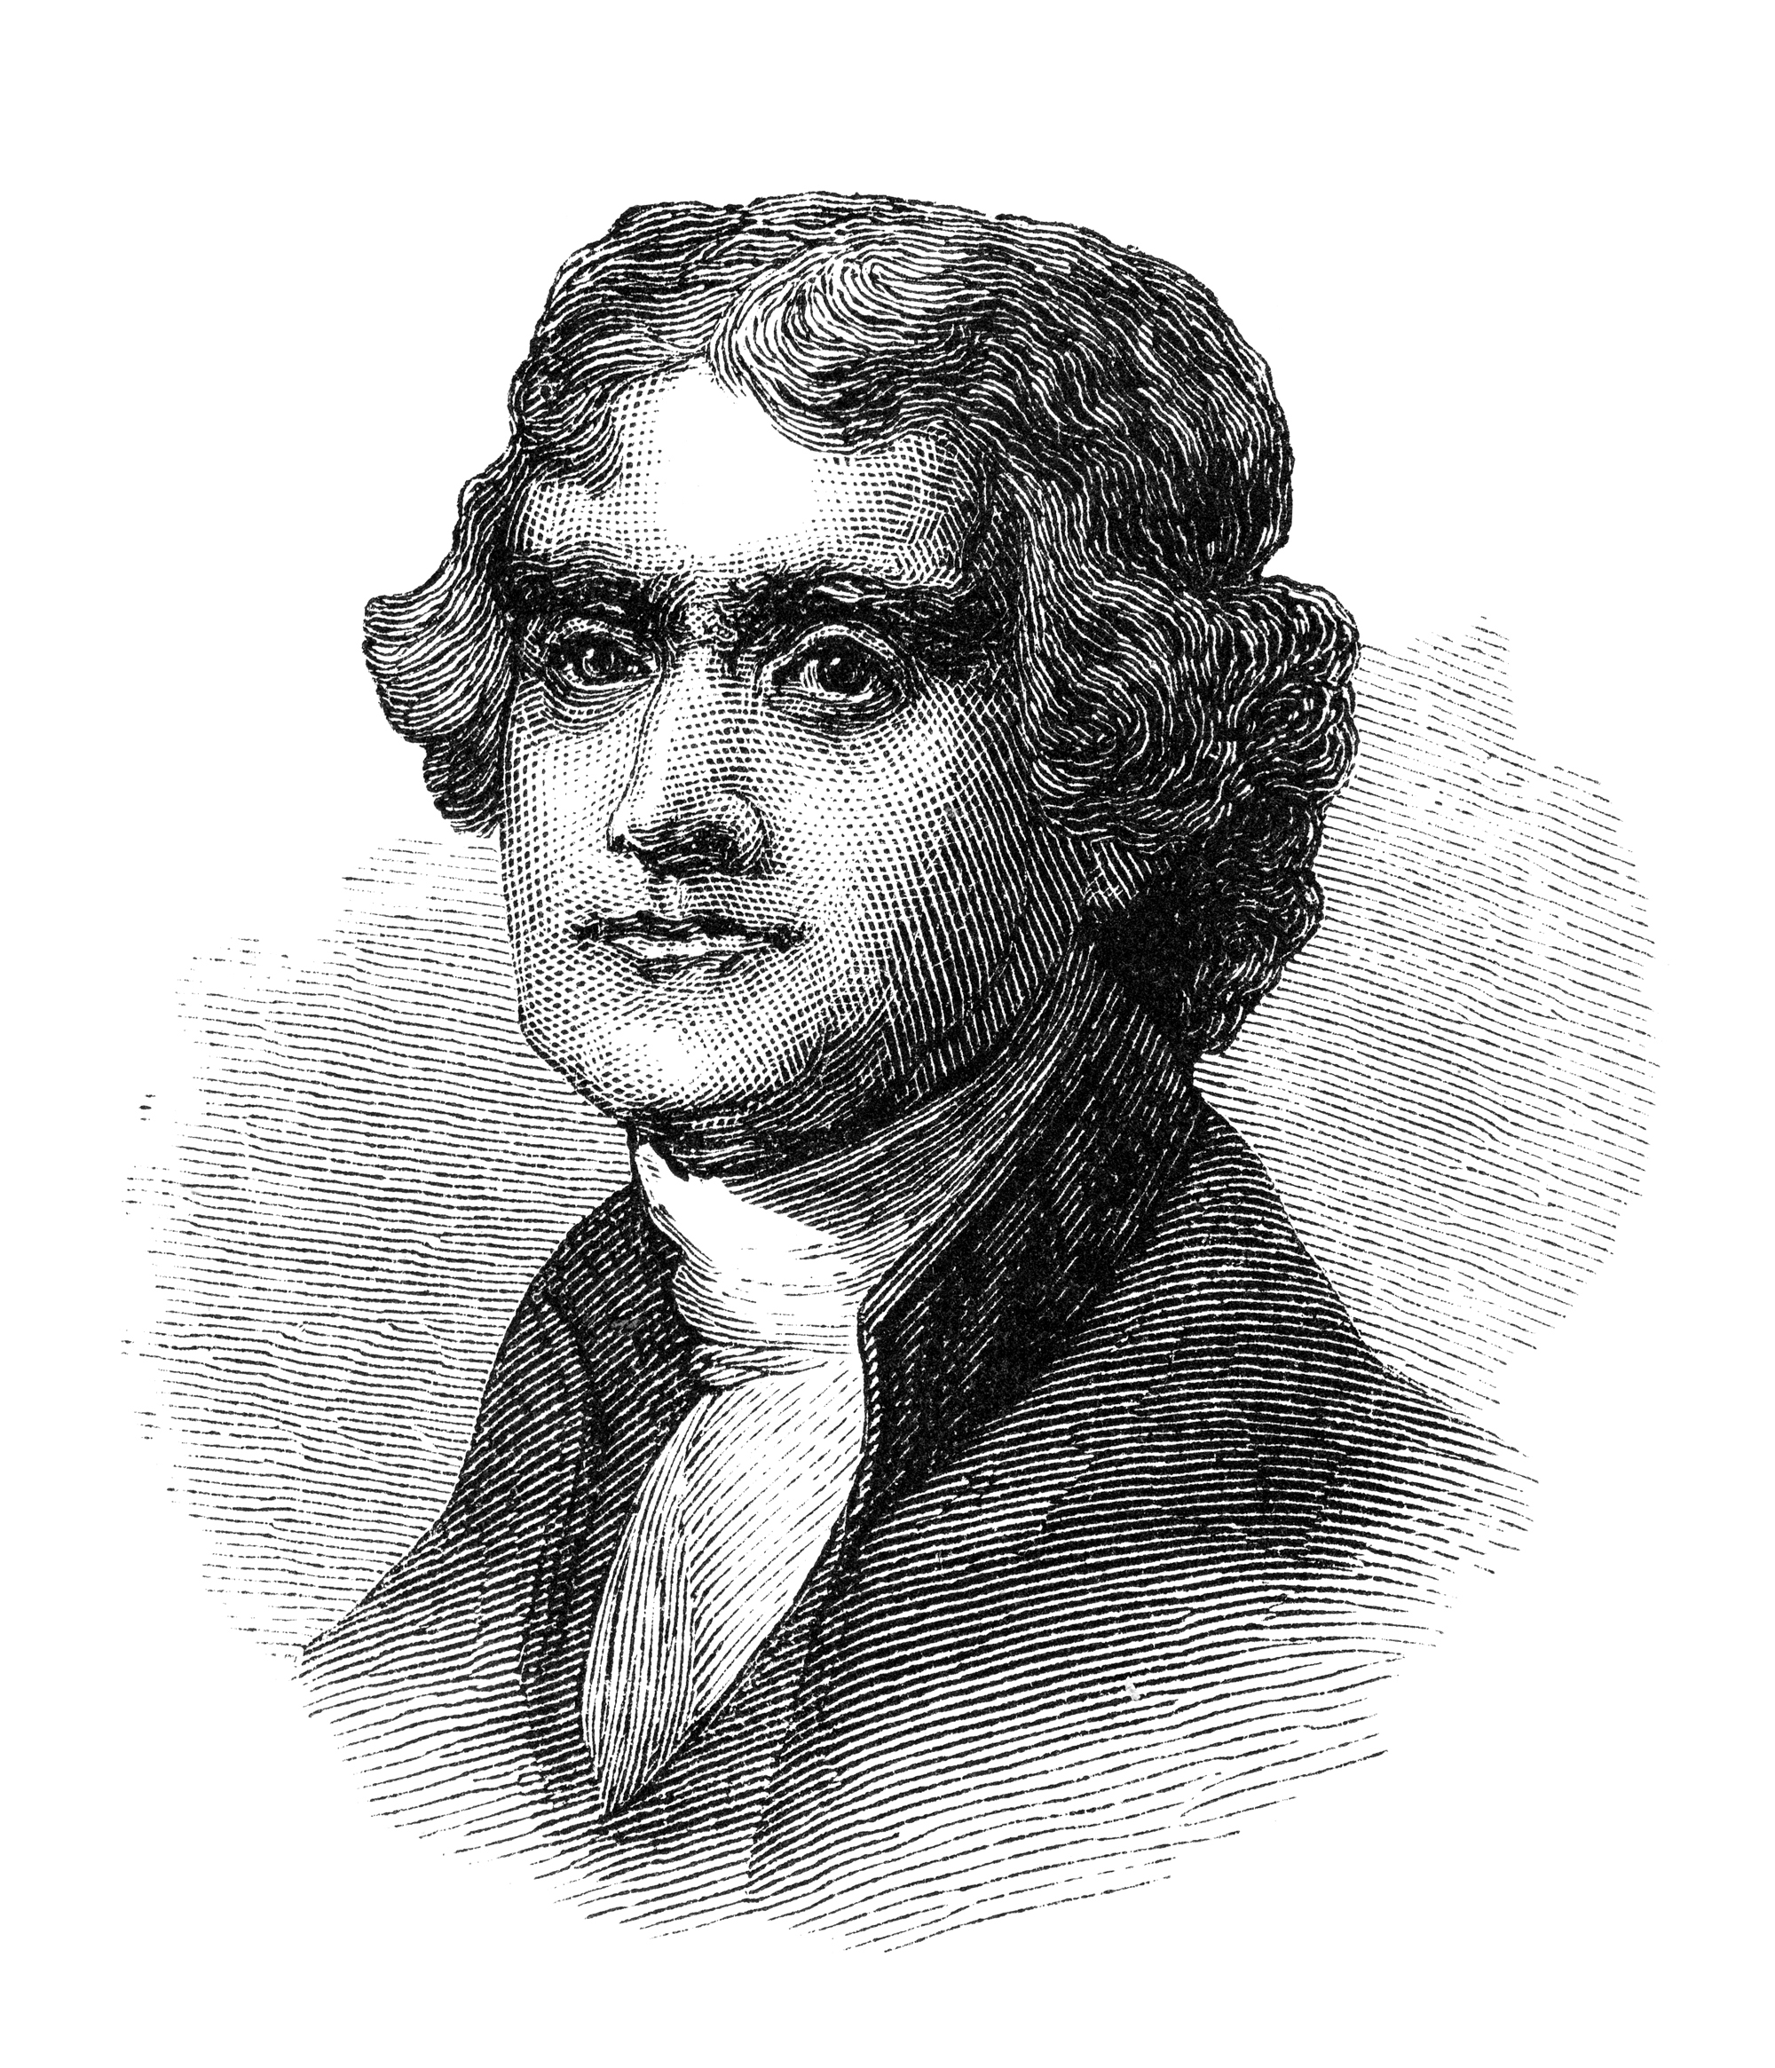
A personal letter from the President of the United States to Dr Jenner
Sir,
I have received a copy of the evidence at large respecting the discovery of the vaccine inoculation which you have been pleased to send me, and for which I return you my thanks. Having been among the early converts, in this part of the globe, to its efficiency, I took an early part in recommending it to my countrymen. I avail myself of this occasion of rendering you a portion of the tribute of gratitude due to you from the whole human family. You have erased from the calendar of human afflictions one of its greatest. Yours is the comfortable reflection that mankind can never forget that you have lived. Future nations will know by history only that the loathsome small-pox has existed and by you has been extirpated.
efficiency | = effectiveness
rendering | = giving
calendar | = list
human afflictions | = human diseases
comfortable reflection | = happy thought

