Slide 1
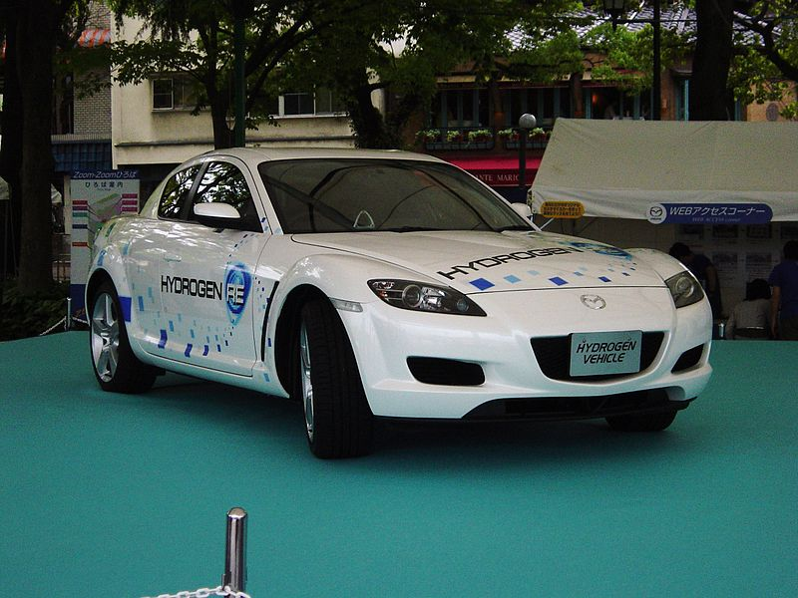
Future Fuel
This resource has been developed by the Association for Science Education for their RCUK-funded series
‘Research focused teaching resources to inspire students in STEM Careers’
Notes:
Photo: Taisyo, Wikimedia Commons
By User:Taisyo (ja:画像:RX8水素ロータリー車.jpg) [GFDL (http://www.gnu.org/copyleft/fdl.html), CC-BY-SA-3.0 (http://creativecommons.org/licenses/by-sa/3.0/) or CC BY-SA 2.1 jp (http://creativecommons.org/licenses/by-sa/2.1/jp/deed.en)], via Wikimedia Commons

Slide 2
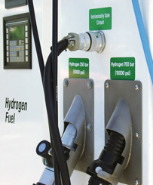
The global research context
Hydrogen: fuel of the future?
Petrol- and diesel-fuelled cars produce carbon dioxide, a greenhouse gas. Hydrogen is a good alternative to fossil fuels, since hydrogen-fuelled cars make one waste product only, water.
However, hydrogen does not exist naturally as an element on Earth, and can be expensive to produce from its compounds. Hydrogen explodes easily in air, so it is difficult to store and transport safely.
Could hydrogen be produced from ammonia? Ammonia is already made on a huge scale for the production of fertilisers. The ammonia is made by reacting nitrogen (from the air) with hydrogen (from water or natural gas).
All over the world, scientists are collaborating to find more sustainable ways of producing and using hydrogen as a fuel for cars.
Notes:
Photo: EERE, Wikimedia Commons [https://www.hydrogen.energy.gov/permitting/stations_storage.cfm]

Slide 3
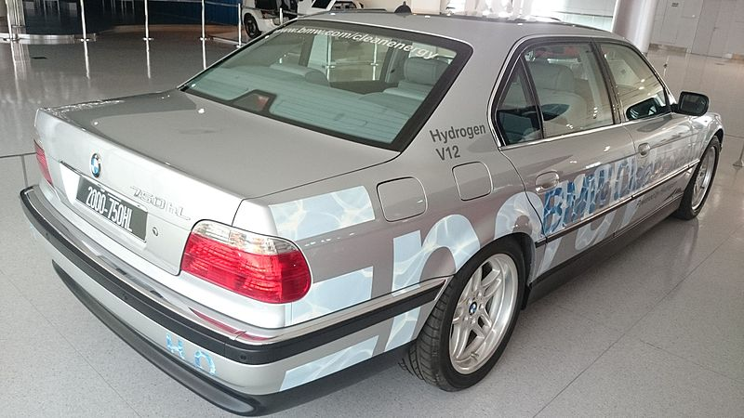
Your BIG Research Question
How can hydrogen fuel be produced safely in cars?
Notes:
Photo: By ChengH (Own work) [CC BY-SA 4.0 (http://creativecommons.org/licenses/by-sa/4.0)], via Wikimedia Commons

Slide 4
Research summary¹
‘Hydrogen (H₂) is an attractive chemical fuel, with a high energy content and emissions free from carbon dioxide. Despite these advantages, its use has been hindered by the lack of an effective and efficient method for its storage.
Ammonia (NH₃) has a high hydrogen density and is produced on an industrial scale. Furthermore, it has an existing extensive distribution network and is easily stored by liquefaction at moderate pressure. While safety risks due to the toxicity of ammonia have detracted from its appeal, its adoption as a source of hydrogen fuel has not yet been realised largely because of the absence of an efficient, low-cost method for converting ammonia to hydrogen and nitrogen.’
One day, says the scientist leading the research, ammonia may replace fossil fuels as a reliable, affordable and sustainable fuel. Of course, it would be vital for the ammonia to be produced from sustainable resources – nitrogen from the air and hydrogen from water.
Questions…
Look at the photograph showing how the hydrogen produced in reactions 1 and 2 can be used to generate electricity for a television (SS1b). Explain how hydrogen could be used to make a car move.
A mixture of hydrogen and oxygen (present in air) may explode if ignited by a spark. Suggest two hazards linked to using hydrogen as a fuel for cars. How might scientists and engineers who design cars and filling stations reduce risks from these hazards?
Ammonia is toxic. It can be stored and transported as a liquid. Suggest two hazards linked to using ammonia as a fuel. How might risks from these hazards be reduced?
Write balanced symbol equations for
the decomposition reaction of sodium amide
the reaction of sodium with ammonia.
Suggest what happens to the sodium that is made in reaction 1 when reactions 1 and 2 happen at the same time.
If reactions 1 and 2 are used to produce hydrogen fuel in a car, explain why
ammonia must be added to the reaction vessel all the time
sodium amide needs to be added only at the start.
Suggest where the nitrogen produced in reaction 1 might end up if the two reactions are used to produce hydrogen fuel in a car.
The scientists tried different ways of making ammonia decompose that could be used to produce hydrogen in a moving car as it is needed.
One method involves sodium amide (NaNH₂). On heating, sodium amide decomposes to its elements (reaction 1): sodium amide → sodium + nitrogen + hydrogen
The sodium produced then reacts with ammonia (reaction 2): sodium + ammonia → sodium amide + hydrogen
Reactions 1 and 2 happen at the same time if sodium amide and ammonia are mixed and heated.
Now investigate your Big Research Question...
How can hydrogen fuel be produced safely in cars?
¹ David WIF, Makepeace JW, Callear, SK, Hunter HMA, Taylor JD, Wood TJ, Jones MO. (2014) Hydrogen production from ammonia using sodium amide J. Am. Chem. Soc. 136: 13082 - 13085.

Slide 5
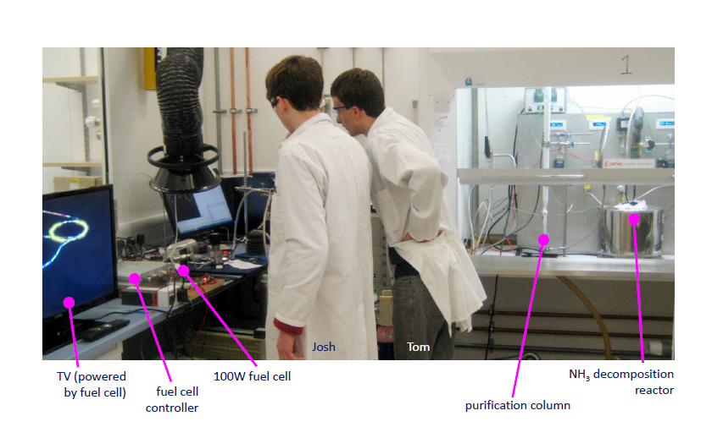
electricity←←100 W fuel cell←←←←←purification←←reactor←←ammonia gas in
Notes:
Thank you to Bill David for permission to include the photograph

Slide 6
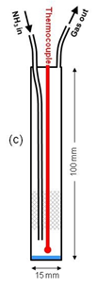
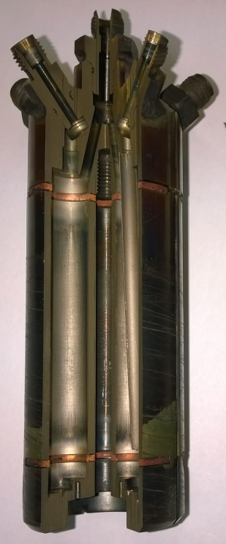
Going deeper…
Once the scientists had shown that sodium amide acts as a catalyst by speeding up the decomposition of ammonia, they asked more questions:
How does the performance of sodium amide compare to other catalysts?
What is the effect of temperature on the decomposition reaction?
The scientists designed investigations to answer their questions.
The investigations
The scientists supplied ammonia gas continuously, and at a steady speed, to a reaction vessel (pictured) over 24 hours. They used instruments to analyse the mixture of gases coming out. Separately, they tested the effects of changing two variables.
Investigation 1 The catalyst. Scientists tested ruthenium- and nickel-based catalysts, which other scientists had already shown work well, as well as sodium amide.
Investigation 2 The temperature of the reaction mixture.
catalyst
Questions…
Look at the graph on Student Sheet 2b. For the sodium amide catalyst, describe the relationship between temperature and the percentage of ammonia converted.
Which catalyst performs best at
350 °C?
500 °C?
Compare the performance of the sodium amide and ruthenium-based catalysts over the full temperature range shown.
The scientists believe that sodium amide is more likely to be used in future as a catalyst for the decomposition of ammonia than the ruthenium-based catalyst. Suggest why.
Explain why the sodium amide in reactions 1 and 2 of the Research Summary can be said to be acting as a catalyst.
Suggest one variable the scientists kept constant in investigation 1.
Suggest one variable the scientists kept constant in investigation 2.
Notes:
Thank you to Bill David for permission to include the diagram and photograph

Slide 7
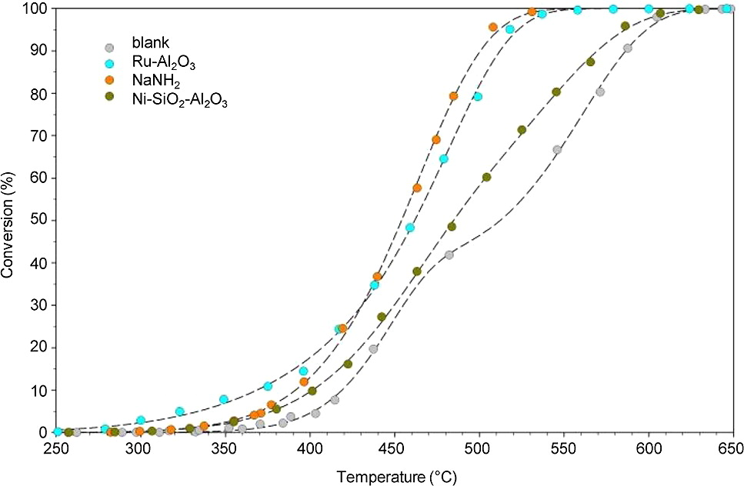
Research graph
The graph below shows the effect of temperature on the percentage of the ammonia supplied that decomposed into its elements as it passed through the reaction vessel. Each line is for a different catalyst.
Empty steel-lined reactor
Ruthenium-based catalyst
Sodium amide catalyst
Nickel-based catalyst
Percentage of ammonia supplied that decomposed into its elements
Notes:
Thank you to Bill David for permission to include this graph

Slide 8
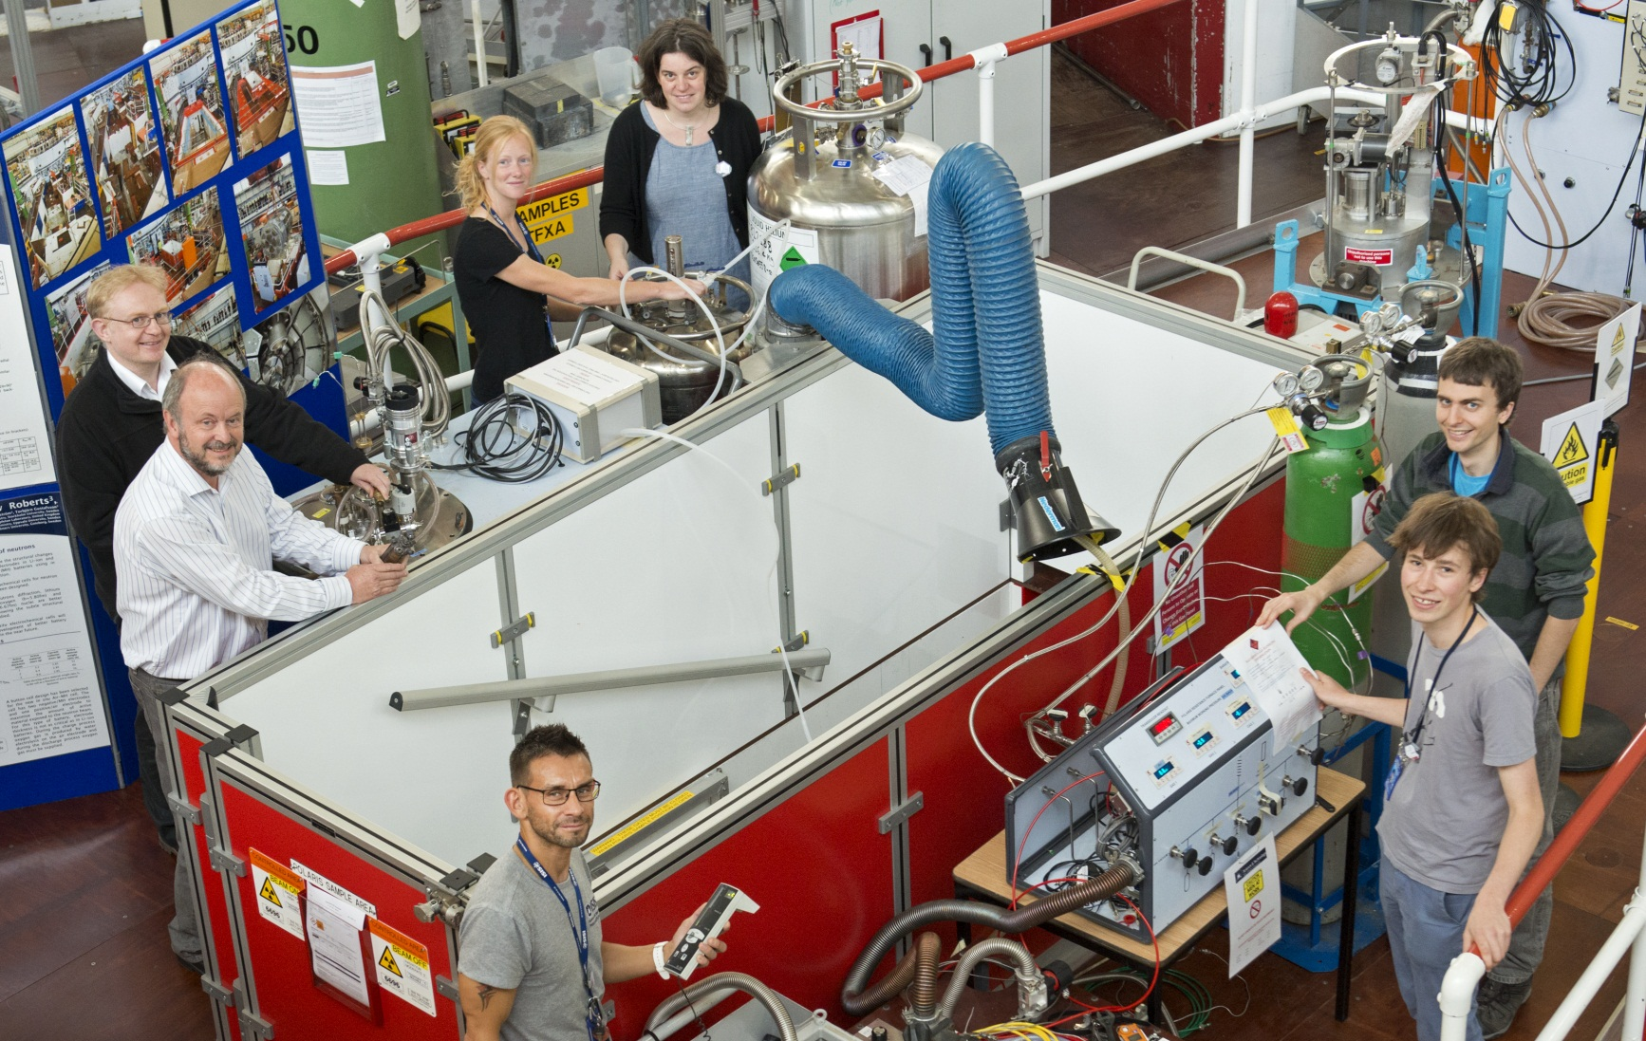
Where can science research take you?
Scientists at the Science and Technology Facilities Council (STFC) are doing this research.
Bill David
Sam Callear
Hazel Hunter
Bill David leads the team. He was part of the group that discovered the lithium battery, 35 years ago.
Hazel Hunter got the demonstrator reactor up and running.
Martin Jones
Mark Kibble
Josh Makepeace
Tom Wood
For more information on science and STEM careers see www.futuremorph.org.
Notes:
Photo: Included with kind permission from Bill David

Slide 9
Useful links
Further information
Hydrogen breakthrough could be a game-changer for the future of car fuels
This article outlines the research and speculates about its possible implications.
Ammonia – a forgotten fuel?
This article, pages 40 to 41, addresses the question: Can ammonia be the long term, carbon-free alternative to fossil fuels?
SFTC project announcement – summaries of four projects – including that described in this activity – which aim to solve energy challenges.
Bill David – this web page tells of a recent award to the lead scientist in the research project.
Other resources from Science and Technology Facilities Council
STFC Explore our science
This page is a window into STFC’s science and technology, and how large facilities – from giant telescopes, to laser facilities, supercomputers and the Large Hadron Collider – help physicists, chemists and biologists to understand our world and the Universe beyond.

Slide 10
Acknowledgements
Research paper
This resource is based on the research paper:
^{1,2} David WIF, ^{1,2} Makepeace JW, ¹ Callear SK, ¹ Hunter HMA, ¹ Taylor JD, ¹ Wood TJ, ¹ Jones MO. (2014) Hydrogen production from ammonia using sodium amide J. Am. Chem. Soc. 136: 13082 - 13085.
¹ ISIS Facility, Rutherford Appleton Laboratory
² Inorganic Chemistry Laboratory, University of Oxford
Thank you to Bill David for permission to use the diagrams, photographs and graph on slides 5, 6, 7 and 8.
Organisations
The research was funded by Science and Technology Facilities Council (STFC)
Bill David is STFC Senior Fellow at the ISIS Facility, Rutherford Appleton Laboratory, Oxfordshire, UK, and Professor of Chemistry in the Inorganic Chemistry Laboratory, University of Oxford, and Fellow in Physics at St. Catherine’s College, Oxford.

