Slide 1
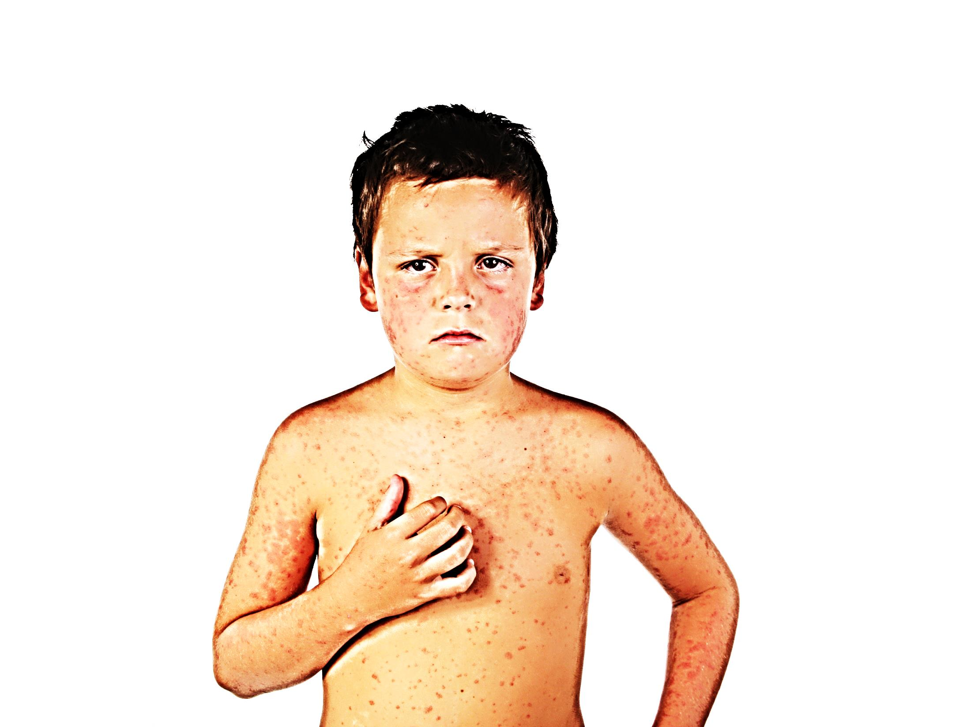
Pupil sheets
Teacher tips:
Look out for the Teacher Tips to the left of the PowerPoint when in normal view.
Episode Two

Slide 2
This activity was produced by the Association for Science Education
in partnership with James Films © 2016
Promoting Excellence in Science Teaching and Learning

Slide 3
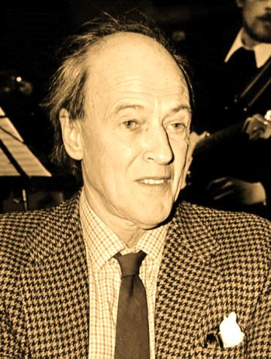
PS1a
Healthcare workers
PS1a
Teacher tips:
Measles can cause very serious complications which can cause lifelong disability or even death; however children may be reassured that with good care the vast majority of patients make full recoveries.
This task analyses Dahl’s persuasive writing. You can edit the list to things you’ve covered.
Most people recover fully from measles in a few weeks. However, in rare cases measles can lead to complications.
Roald Dahl’s daughter Olivia died of measles in 1962, before vaccination was available. You can read the account he wrote after her death (link at the bottom).
Then read “Measles: a dangerous illness”. He wrote this after a vaccine had been invented, in order to try and persuade parents to get their children vaccinated.
How many of these can you spot?
a fact
an opinion
a short sentence for effect
statistics (data used as evidence)
a rhetorical question
a question with a factual answer
a modal verb
emotive language
a sentence addressing the reader directly
ovg.ox.ac.uk/blogs/ojohn/how-dangerous-measles

Slide 4
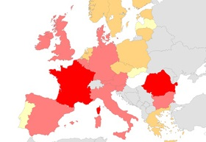
PS1b (optional maths)
According to Roald Dahl, 20 out of every 100,000 people who catch measles will sadly die.
1. Copy and simply the fractions:
$\frac{20}{100,000}=\frac{2}{ 10,000 }=\frac{1}{ }$
This means that 1 out of every __________ people who catch measles will die.
In 2011 there were about 25,000 cases of measles in Europe altogether.
2. Using your answer to Question 1, how many deaths would you predict from 25,000 cases?
PS1b
Teacher tips:
This sheet contains optional maths questions. There is space on the slide to add extra support for some children.
1. $\frac{20}{100,000}=\frac{2}{ 10,000 }$ $=\frac{1}{ 5,000 }$
2. 25,000 $÷5,000$
= 25 $÷$ 5 = 5
Or
20 out of 100,000 = 10 out of 50,000
= 5 out of 25,000
So you’d predict 5 deaths. In actual fact there were 9 deaths from those measles cases.
3. The MMR vaccine was rigorously tested over many years before it was introduced. Also, because the MMR vaccine has since been used on so many people over so many years we have lots of data about it and we can be confident it is effective and safe.
You can explore these ideas further with children in the Dr Edwina Jenner – Immunologist activity.
Ask a data analyst what happened to the number of measles cases in the UK after the measles vaccine was introduced in 1968.

Slide 5
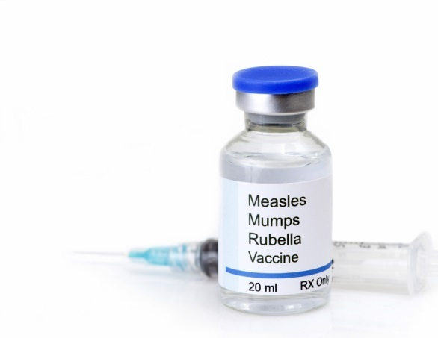
PS2
Science advisors
PS2
Teacher tips More about MMR safety, side effects, and the discredited autism scare:
www.ovg.ox.ac.uk/mmr-vaccine
Children can learn more about the safety and testing of vaccines in the Dr Edwina Jenner: Immunologist resource.
The MMR vaccine
The MMR vaccine was introduced in the UK in 1988.
Over the last thirty years, millions of people across the world have had the MMR vaccine so we know it is safe.
In some cases it can make you feel a little bit unwell for a few days – but much less seriously than if you had full-blown measles.
Which three diseases does the MMR vaccine protect you from?
Why are doctors so confident that the MMR vaccine works and that it is safe?

Slide 6
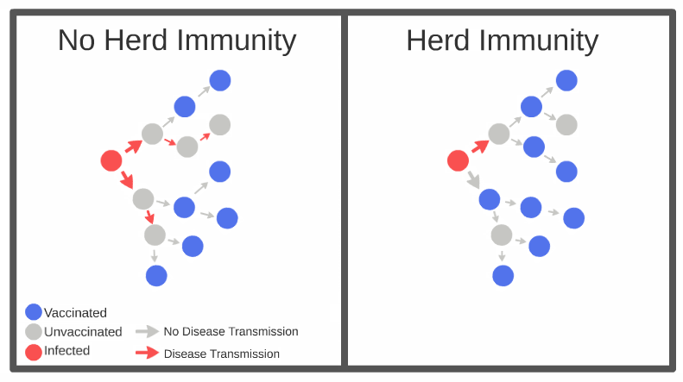
PS2b
PS2b
Herd Immunity
If 95% or more of a community are vaccinated (meaning less than 5% are unvaccinated) then measles is unlikely to spread, even among unvaccinated people. This is called herd immunity.
Some children recently did not have the MMR vaccine due to a false scare about its safety. Look at the data below from a town in Scotland. Does this community have herd immunity or are they at risk of experiencing a measles outbreak among the unvaccinated people?
Teacher tips: Children should make the link with their learning from the Speckled Monster activity and how vaccination can stop a disease spreading. Vaccination is not just about protecting yourself, but to help protect your entire community – especially vulnerable people who cannot be vaccinated for medical reasons.
Children could watch this clip which explains herd immunity using gummi bears https://www.youtube.com/watch?v=CPcC4oGB_o8
or look at this diagram from Wikipedia
https://upload.wikimedia.org/wikipedia/commons/c/c0/Community_Immunity.jpg
or the picture opposite from
http://www.brookings.edu/blogs/health360/posts/2015/02/06-measles-vaccines-mmr-herd-immunity-antivaxxers-patel
Or you could recreate the simulation using coloured counters etc…
1. In this example 87 + 2 = 89% of people are immune whilst 10+1 = 11% are not immune. The percentage who are immune is NOT high enough for herd immunity. Therefore the disease can spread and non-vaccinated individuals are at risk. (Fully vaccinated people are still safe from measles).
This information should be discussed with the data analysts who should have worked out that the local population does not have herd immunity and therefore that measles will easily.
Fully vaccinated (both jabs) | 87%
No vaccination | 10%
First jab only and immune | 2%
First jab only and not immune | 1%
Questions
What is the total percentage of people who are immune?
What is the total percentage of people who are not immune?
Now talk to the data analysts to find out if your area has herd immunity.

Slide 7
PS3a
Data analysts
PS3a
Teacher tips:
This activity provides practice in percentages for the children. The total percent must of course equal 100 so the % of children who ARE vaccinated may be calculated by subtracting the unvaccinated % from 100.
Age group | % vaccinated | % not vaccinated
1 | 95.1 | 4.9
2 | 94.2
3 | 95.2
4 | 95.7
5 | 95.3
6 | 94.8
7 | 93.6
8 | 92.1
9 | 89.7
10 | 87.6
11 | 84.1
12 | 85.5
13 | 86.9
14 | 86.2
15 | 88.2
16 | 89.9
17 | 92.1
18 | 93.2
The table shows the percentage of children in your area who are vaccinated against measles.

Slide 8
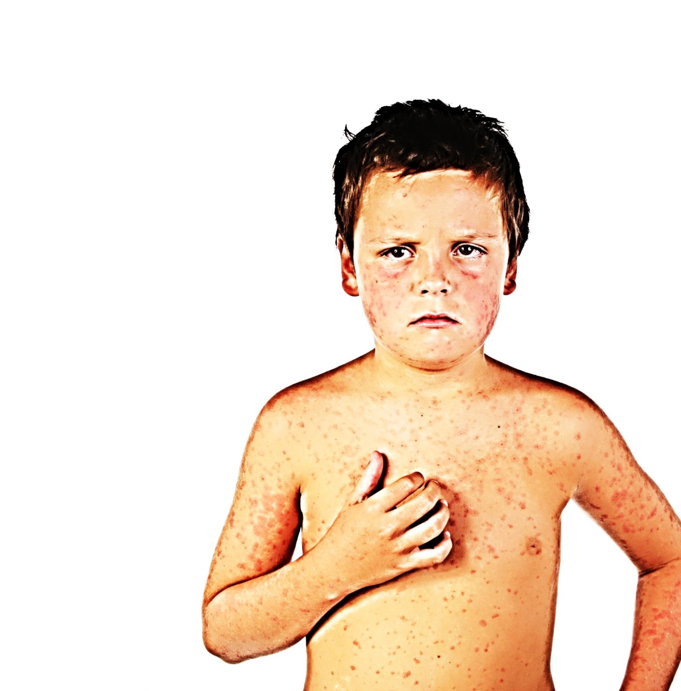
blank
PS3b
For each age group, work out what percentage of children who are not vaccinated.
Which age groups do you predict will be most affected by the measles outbreak?
What is the average (mean) percentage not vaccinated across all ages 1 to 18?
Complete the sentence:
___ out of 100 children in the local area are at risk of catching measles.
PS3b
Teacher tips:
There is space on this slide to add some extra support to questions 3 and 4 for some children.
To find the average percentage not vaccinated, add up all the percentages in the right-hand column then divide by 18.
160.6 ÷ 18 = 8.9 % (rounded up).
So almost 9% or $\frac{9}{100}$ children are at risk of catching measles.
And only 91.1% of children are vaccinated.
When the data analysts talk to the science advisors they will find that this is below the level needed for herd immunity (95%) which indicates that the community is at risk from a major outbreak.
A reasonable prediction is that the worst affected age groups will be the ones with the highest percentage of unvaccinated children.
Now talk to the science advisors to find out whether this means that your area is at risk of a major outbreak!

Slide 9
PS4a
Questions for press conference
Teacher tips:
You could ask the class to submit more questions. These could be added to the table.
From their learning during this episode, children should be able to mention vaccination in their answers both as a cause of the outbreak (because many people are unvaccinated) and a solution (parents should vaccinate their children if they are not already vaccinated).
You might like throw in some surprise questions about vaccination, e.g.
‘How do we know that the measles vaccine is safe?’ (the science advisers should be able to answer this), ‘If people catch measles can they get a vaccination to cure them?’ (No! Vaccination is not a cure) ‘I’m fit and healthy, I won’t die of measles. So why should I get vaccinated?’ (To stop you catching an unpleasant disease, and stop you spreading it to vulnerable people).
Question | Who will respond
1. Is this outbreak spiralling out of control? | Data analysts
2. We have had one death already. Parents are terrified. What reassurance can you give parents and what can they do to protect their children? | Healthcare workers (ask for advice from science advisors)
3. It is outrageous that you have imposed these emergency measures. People just want to get on with their day to day lives. Why did you do it? How long will they last? | Science advisors (discuss with data analysts)
PS4a
Notes:
Teacher tips:

Slide 10
PS4b
Questions for press conference
PS4b
Teacher tips:
Space for further questions if needed.
Question | Who will respond
Notes:
Teacher tips:

