Slide 1
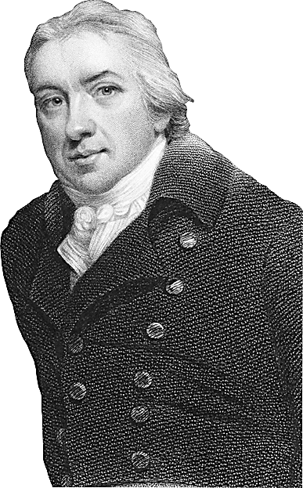
Pupil sheets
Teacher tips:
Look out for the Teacher Tips to the left of the PowerPoint when in normal view.
Episode Four

Slide 2
This activity was produced by the Association for Science Education
in partnership with James Films © 2016
Promoting Excellence in Science Teaching and Learning

Slide 3
PS1
Outbreak evaluation report
PS1
What is required in the report | Who is producing this
A graph to show the number of cases of measles plus answers to: what was the peak number of new cases in a single week? what was the total number of cases? approximately how long did the outbreak last? Add labels to the measles cases graph with key events.
An explanation of who was offered the emergency vaccinations when and why.
An explanation of why your area was at risk of a major outbreak in the first place and why the area is now unlikely to experience another outbreak.
An evaluation as to how successful your overall campaign was.
Teacher tips:
The report could be produced in a variety of formats e.g. poster, computer presentation, spoken presentation, video.
Notes:
Teachers notes:

Slide 4
PS2
Data analysts
PS2
Cut out the following labels and add them to the measles cases graph at the correct points on the graphs. Complete the sentences to explain why the data made the team take the different actions.
For example:
The outbreak was declared over because the data showed there were no new cases of measles.
Teacher tips:
A vaccination campaign was started because
Emergency measures were introduced because
The outbreak was declared over because
Letters to parents were written because
A red alert was issued because
A letter to the government was written because
Notes:
Teacher tips: Completed answers in the order they should appear on the graph. These could be copied onto the graph if there is not enough space to stick the labels.
Emergency measures were introduced because the number of measles cases was not dropping.
Letters to parents were written because the number of measles cases was starting to rise more steeply.
A letter to government was issued because the number of measles cases was starting to rise more steeply.
A red alert was issued because the number of measles cases started to rise very steeply.
The outbreak report was started because number of cases was starting to drop.
The outbreak was declared over because there were 0 cases of measles.

