Slide 1
Pupil sheets
Look out for the Teacher Tips to the left of the PowerPoint when in normal view.
Teacher tips:
Additional information, links and answers will appear to the side of the slide when in normal view.
Episode One

Slide 2
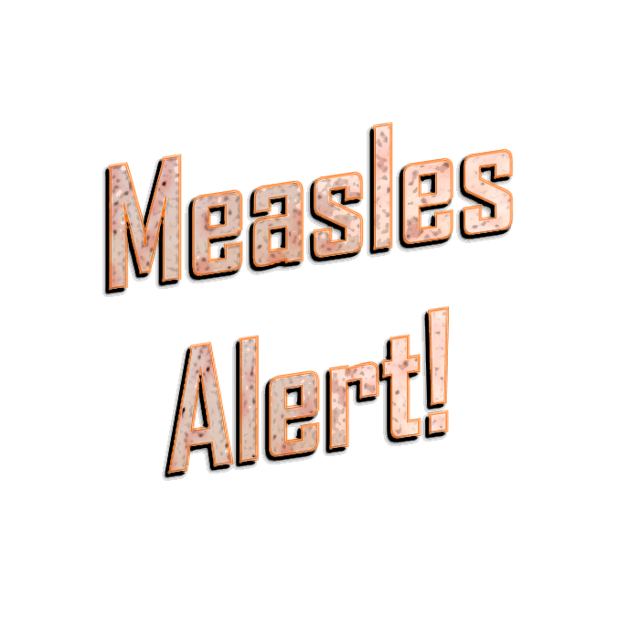
This activity was produced by the Association for Science Education
in partnership with James Films © 2016
Promoting Excellence in Science Teaching and Learning

Slide 3
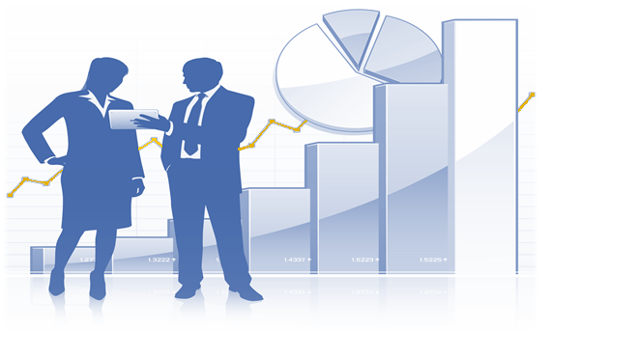
PS1a
Data analysts
PS1a
Teacher tips:
Children might think they need numbers to draw a graph but this task encourages them to think about the shape of the graph first. The sketched graph should look similar to the smallpox outbreak graphs from the Speckled Monster resource (like a hill with steep slopes). It doesn’t matter if the graph sketched is flatter on the top.
More able children could also be challenged to try and sketch a similar graph for a less severe outbreak. For this, the number of cases goes up and comes down more slowly and the peak number of cases would be less. This would look like a shorter hill with less steep slopes.
Training Questions
What do you predict the graph will look like?
Sketch the axes of the graph then draw on a graph where
the number of new cases starts to go up quickly
then the number of new cases stays the same for a short time
then the number of new cases goes down quickly
Record the number of new measles cases reported each week in the table and begin a measles cases line graph.
Draw weeks along the horizontal axis and the number of new cases on the vertical axis. Prepare for the worst – a previous outbreak in another town saw up to 180 new cases in a single week and lasted a whole year!

Slide 4
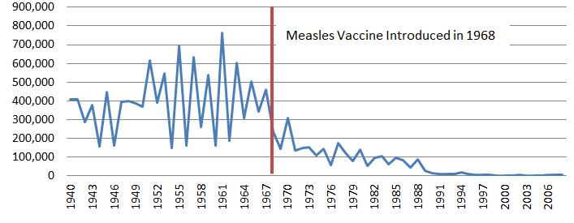
PS1b
MMR Vaccine (data analysts)
PS1b
A vaccine stops you catching a disease. This protection is called immunity. A measles vaccine was first introduced in the UK in 1968. A combined measles, mumps and rubella (MMR) vaccine was introduced in 1988.
To guarantee immunity, two doses of MMR vaccine are needed. The first is given to children at the age of 13 months and the second at the age of 3 years.
What is the other way of becoming immune to a disease?
Teacher tips:
With many diseases, once you catch it and recover, your body becomes immune to it.
(Mothers can pass on immunity to their babies, but this maternal immunity starts to wear off when the baby is about 6 months old.)
1. Children should link the highest point on the graph with the highest number of cases. The worst measles outbreak was in 1961. The scale only goes up in 100,000s so children
Training Questions
The graph shows the total number of measles cases in England and Wales each year.
In what year was the worst measles outbreak? How many cases were there that year?
What happened to the number of cases when the measles vaccine was introduced?
How can people be protected against measles?
will have to estimate the number of cases in 1961. Anything between 750,000 - 780,000 cases. The actual figure was 763,500 cases.
You can find the original figures here:
www.gov.uk/government/publications/measles-deaths-by-age-group-from-1980-to-2013-ons-data/measles-notifications-and-deaths-in-england-and-wales-1940-to-2013
2. The number of cases dropped after the measles vaccine was introduced in 1968. 3. Conclusion: a vaccine stops people from catching measles.
Together, the MMR and subsequent booster give you over 99% certainty of being protected against measles.
(Some children incorrectly assume from the graph that measles began in 1940 – but that is just the year this particular graph starts. Measles is thought to have evolved in about 500 AD.)
Extension question: 4) Just by looking at the graph, can you estimate the average number of measles cases each year before 1968? By looking at the graph you can see that the average number of cases before 1968 was about 400,000 each year. So before vaccination almost everybody caught measles at some point during their childhood. The spikes in the graph mean there was an epidemic that year. You can see that there was an epidemic about once every three years.
Graph: https://www.ovg.ox.ac.uk/measles

Slide 5
PS1c
Data analysts – data sheet
PS1c
Record the measles data on this table.
Teacher tips:
You can provide a starting point for the scale on each axis to help children needing more support. Children will probably have to stick two pieces of graph paper together to fit in all the weeks, or divide each big square on the graph paper into two weeks.
Week | Number of measles cases
1
2
3
4
5
6
7
8
9
10
11
12
Week | Number of measles cases
13
14
15
16
17
18
19
20
21
22
23
24
Week | Number of measles cases
25
26
27
28
29
30
31
32
33
34
35
36
Week | Number of measles cases
37
38
39
40
41
42
43
44
45
46
47
48

Slide 6
PS1d
Encryption key (data analysts)
PS1d
A | 3
B | 1
C | 9
D | 2
E | 0
F | 8
G | 0
H | 5
I | 0
J | 6
K | 4
L | 0
M | 1
N | 2
O | 1
P | 8
Q | 0
R | 9
S | 2
T | 0
U | 1
V | 6
W | 0
X | 7
Y | 1
Z | 0
$ | 1
# | 3
Teacher tips: Since only the data analysts will be able to read the encrypted messages, they must make sure they announce information to the rest of the OCT.
The data will be encrypted using this code.
For example, WCF means 98 new cases.
Remember to share the data with the other members of the Outbreak Control Team!
W | C | F
0 | 9 | 8

Slide 7
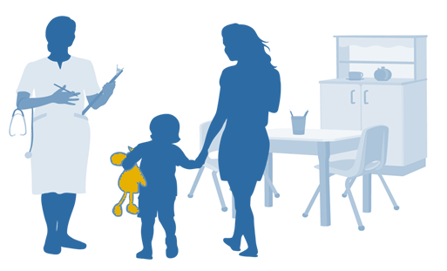
PS2a
Healthcare workers
SS4a
PS2a
Teacher tips:
You might like to show children a video made by some of their healthcare worker colleagues about good hand hygiene… www.youtube.com/watch?v=TGddyTW5eMc
Always wash your hands:
before eating anything
before handling a baby
after going to the toilet
after caring for a sick person
after coughing or sneezing
before entering hospital wards
As healthcare workers you’ll need to advise people on how they can stop spreading and catching germs.
One way to do this is good hand hygiene.
Germs on your hands can get in your body when you touch your mouth or nose.
Unfortunately, most people don’t wash their hands frequently or thoroughly enough.

Slide 8
PS2b
PS2b
People should wash all parts of their hands for at least 15 seconds, using soap.
Look at the picture. The darker bits are the places most people miss out!
Teacher tips:
The contacts who are at risk are those who are NOT vaccinated.
The contacts whose health is most at risk are those who have other health problems or who are pregnant. They are more likely to suffer serious complications.
All four children had spent holiday time at Hightops holiday park so this is likely to be where the outbreak started.
Ibrahim attended school whilst he was ill, and as the science advisors know, this means that there is a strong chance that he has infected other students at the school.
Children can look at this video for handwashing tips from some healthcare worker colleagues:
www.youtube.com/watch?v=TGddyTW5eMc
Now down to work! You must contact all the families where a family member has caught measles.
Ask a data analyst or science advisor to tell you who is most at risk
List the contacts who are at risk of catching measles.
Out of this list, circle contacts whose health is most at risk if they did catch measles.
Can you work out where the outbreak started?
Who else should you contact to warn that they might have been exposed to measles?

Slide 9
PS2c
Measles patient family questionnaires (healthcare workers)
PS2c
Patient details: | Isabel Davies | 11 Years 0ld | Fiveways Secondary School
Close contacts (health details): | Mum (Julie) Vaccinated Healthy | Dad (James) Vaccinated Healthy | Sister (Chloe, 9) Not vaccinated Healthy
 | Aunty (Becky) Not vaccinated Pregnant | Uncle (Will) Vaccinated Healthy | Cousin (Ed, 2) Vaccinated Healthy
Recent travel history | Cousin’s birthday party a week before feeling ill. | Hightops Holiday Park (half term holiday weekend away) | Felt ill on Friday evening and did not attend school on Monday.
Patient details: | Oliver Jones | 10 Years 0ld | Parkfield Primary School
Close contacts (health details): | Mum ( Donna) Vaccinated Has asthma | Dad (Nick) Vaccinated Healthy | Brother (George,13) Not vaccinated Wheelchair user
 | Granny (Chris) Not vaccinated, had measles as a child / Has heart condition
Recent travel history | Hightops Holiday Park (half term holiday week away) | Local park five days before feeling ill. | Sent home from school feeling ill

Slide 10
PS2d
PS2d
Patient details: | Ibrahim Choudury | 12 years old | Olwyn Secondary School
Close contacts (health details): | Mum ( Alia) Not vaccinated Healthy | Dad (Ragib) Not vaccinated Healthy | Sister (Madhiya, 2) Vaccinated
 | Aunty (Rahima) Not vaccinated Pregnant | Uncle (Aktar) Not vaccinated Healthy | Cousin (Shamim, 2) Vaccinated Healthy
Recent travel history | Football club four days before falling ill | Hightops Holiday Park (half term holiday week away) | Struggled to school for one day whilst feeling ill
Teacher tips:
This activity provides practice in percentages for the children. The total percent must of course equal 100 so the % of children who ARE vaccinated may be calculated by subtracting the unvaccinated % from 100. The average not vaccinated is 124.9 ÷ 17 = 7.3 %.
So the average vaccinated is only 92.7%. When the data analysts talk to the science advisors they will find that this is below the level needed for herd immunity (95%) which indicates that the community is at risk from a major outbreak.
Children
Patient details: | Josh Morris | 2 years old | Does not attend school or nursery
Close Contacts (health details): | Mum (Debbie) Not vaccinated Healthy | Sister (Ellie, 13) Not vaccinated Healthy | Granny (Maggie) Not vaccinated Has heart condition
 | Granny (Mary) Not vaccinated, had measles as a child / Healthy | Grandpa (John) Not vaccinated Has diabetes
Recent travel history | Trips to local park | Is looked after by Granny and Grandpa three days a week while his Mum is at work. | Hightops Holiday Park (half term night away)

Slide 11
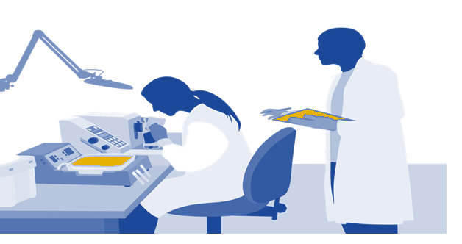
PS3a
Science advisors
PS3a
SS7
Teacher tips:
Measles is so infectious that if someone in your household catches it there is a 90% chance that you will catch it from them!
Certain existing health condition can make catching measles much more dangerous. For example, children with a weakened immune system, such as those with leukaemia.
What is measles?
Measles is one of the most highly infectious (easy to catch) diseases. It is caused by a virus. There is no medicine to cure measles if you catch it (antibiotics only work against bacteria, not viruses).
Most people recover fully from measles.
However, measles can occasionally lead to serious complications such as an infection of the lungs or brain which can lead to death.
If a pregnant woman catches measles it may cause problems for the baby. It can also be dangerous for infants and very old people, and people who already have a serious health problem.
Measles symptoms:
cold-like symptoms
a high temperature (fever)
greyish white spots in the mouth and throat
after a few days, a red spotty rash appears

Slide 12
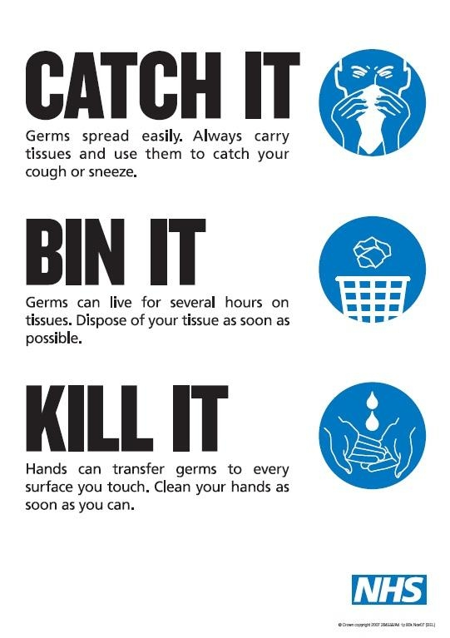
How does measles spread?
The symptoms take about 10 days to develop. The virus is transmitted (spread) in the droplets that leave the mouth and nose of the ill person when they cough and sneeze. You can catch measles by breathing in these droplets, or by touching a surface where the droplets have landed and then touching your nose or mouth.
A patient can start infecting other people as soon as the first cold-like symptoms appear.
How can people be protected? A vaccine stops people from catching measles. You must be vaccinated before you are exposed.
PS3b
Teacher tips:
1. Measles is spread via droplets from the nose and mouth. The cold-like symptoms such as sneezing can spread the disease, but appear several days earlier than the much more distinctive rash. So someone may not realise at first that they have measles – they might think it’s just a cold. (Patients stop being infectious about 4 days after the rash appears. )
2. Measles spreads incredibly easily and has potentially life-threatening effects.
Training Questions
Can you explain how someone can spread measles before they realise they have it?
Give two reasons why it is important that people are made aware if there is a measles outbreak.
How does the poster say people can help stop measles and other germs spreading? What other ways can you think of?
PS3b
Informing people about an outbreak is important so that anyone with cold-like symptoms realises that they might have measles and can take precautions to stop it spreading. It might prompt people to get themselves or their children vaccinated if they haven’t already in order to protect them from it.
3. The poster is about preventing the spread of germs through sneezing and coughing. You shouldn’t get too close to a sick person . The healthcare workers also know that people should always wash their hands thoroughly with soap and water after going to the toilet and before eating, and that they shouldn’t put their hands in their mouths. Sick people should stay at home to stop them spreading their illness at school or work – an example of quarantine or isolation that children met in the Speckled Monster activity.

