Slide 1
Pupil sheets
Teacher tips:
Look out for the Teacher Tips to the left of the PowerPoint when in normal view.
Episode Three

Slide 2
This activity was produced by the Association for Science Education
in partnership with James Films © 2016
Promoting Excellence in Science Teaching and Learning

Slide 3
PS1a
PS1a
Healthcare workers
Science advisors
Teacher tips:
This is an opportunity to practice literacy skills in persuasive writing and to think about the audience they are writing for.
The best leaflets and letters will be honest and factual and persuasive without scaremongering about death. They should include the risk of death, but make clear that it is rare.
Children might want to include the symptoms of measles in their leaflets and letters.
You must explain that there is an outbreak of measles and tell them to let an adult know if they feel unwell.
Include a section for parents to persuade them to get their children vaccinated.
Create a leaflet to hand out to primary school children.
Write a letter to be sent out to parents in the area.
Teacher tips:
The writing output on this sheet can be changed to reflect choices made by children. This is an opportunity to practice literacy skills in persuasive writing and presentation of information. You can get children to do a Google image search of “measles poster” for some ideas… Children should remember that the risk of death from measles in this country is very small indeed, so leaflets or letters that claim that unvaccinated children are LIKELY to die are misleading and inaccurate.
Your letter should inform parents of the outbreak and persuade them to vaccinate their children .
Explain the dangers and the unpleasantness of measles.
Remember to communicate clearly and be careful not to frighten young children.
Show that the MMR vaccine is the best way to protect children
Reassure people that the MMR vaccine is safe
Explain the risks of measles, but be careful not to exaggerate them - deaths from measles are very rare
PS1a

Slide 4
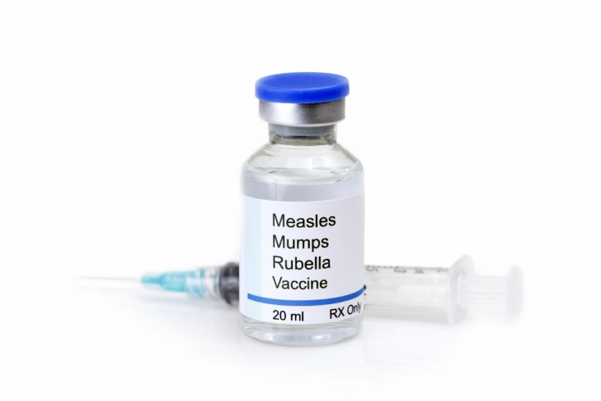
PS1b
Data analysts
Teacher tips:
Add extra support to the maths question if needed.
10% of 680,000 = 68,000
Write a letter to the government to persuade them to urgently send you a large quantity of MMR vaccine.
Use data to support your argument, especially the numbers of cases and any data that explains the risk of a major outbreak in the area.
Are you going to illustrate this data with a graph?
Are you going to include information on the dangers of measles? Make sure you don’t exaggerate them.
There are 680,000 children (aged 18 or younger) in your area. About 10% of them are not vaccinated. How much vaccine do you need to ask for?
PS1b
Notes:
Teacher tips:

Slide 5
PS2a
Healthcare workers
PS2a
The bar chart shows data for a recent measles outbreak in another town.
Which three age groups were the worst affected by the outbreak? Can you think of any reasons why this might be the case?
Which age groups were least affected? Can you think why?
What pattern do you see in the data?
Assuming this pattern is the same in your area, who should you prioritise in your emergency vaccination campaign?
Teacher tips:
You might like to spend some time with this group to discuss the patterns and explanations of this graph… Children should discover that the three most affected age groups are 0, 1-4, and 5-34. The least affected age groups were the oldest ones. The pattern is that the number of cases falls as age increases.
For a challenge, you can ask why the units on the vertical axis are “number of measles cases per 100,000 people”. The reason is that the age groups on the horizontal axis are not all the same size – for example the first
You can discuss the questions with a science advisor or data analyst
bar only counts children under 1 year old, whilst the second bar includes children aged 1, 2, 3 or 4 years old, so contains four times as many children. So in order to be a fair comparison, the data is given as cases per 100,000 people – like a percentage but out of 100,000 rather than 100 because the numbers are very small. For example, the first column is
$\frac{360}{100,000}=$ 0.0036 $=$ 0.36 %
so 0.36% of babies in the 0 age group caught measles.
The pattern probably results from a combination of reasons – mostly to do with vaccination and social behaviour. Children might come up with alternative explanations.
Babies are always putting things into their mouths and have lots of close contact with people, so pick up diseases easily. Younger children also tend to be less hygienic – for example they tend not to wash their hands very thoroughly and pick their noses! Often they share toys which can transfer germs. Also, schools are very “good” places for spreading diseases because often many hundreds of children are all mixing together.
Children in the 1 – 4 age group will begin to be vaccinated, but most will have only had one jab and not the booster, so only about 90% of those vaccinated will be protected. (Children are normally vaccinated after their 1st birthday because the vaccination is not effective before that age, and any maternal immunity inherited from an immune mother starts to wear off at about 6 months.)
If the area is similar to yours then the data analysts and science advisors should know from Episode Two that between 5 and 10 percent of children have not been vaccinated, which might explain why infection rates are high among children.
On the other hand, anyone over about 50 would have been born before the measles vaccine was introduced. However, they will almost certainly be immune to measles. Why? Because measles is so contagious, before the vaccine almost EVERYONE caught it during childhood. So older people have natural immunity.

Slide 6
PS3a
Data analysts
PS3a
Teacher tips:
Seeing the data displayed in a graph is often a really quick and easy way of spotting any patterns in the data.
Children will probably decide that the age groups with the highest percentage of unvaccinated children should be prioritised (ages 9 – 10) …
Conversely, they might also argue that younger children and babies and old people should be given priority because they are more vulnerable.
This is a bar chart of the table you completed of the percentages of unvaccinated children in different age groups in your area.
Questions
How does looking at a graph help you analyse the data?
In which age groups are 10% or more children unvaccinated?
In which age groups are 6% or fewer children unvaccinated?
Based on this data, who should be prioritised in your emergency vaccination programme?

Slide 7
PS2b (alternative)
Healthcare workers
PS2b
The table contains data for a recent measles outbreak in another town.
It shows the number of measles cases out of every 100,000 people in different age groups.
Draw a bar chart of the data then answer the questions:
Which age groups were worst affected by the outbreak?
Can you think of any reasons why this might be the case?
Which age groups were least affected? Can you think why this might be so?
What pattern do you see in the data?
Assuming that this pattern is the same in your area, who would you prioritise in the emergency vaccination campaign in your area?
Teacher tips:
This is an even more challenging alternative to PS2a which allows children to draw their own bar graph.
The data suggests that you should prioritise the vaccination of younger children as these are the worst affected by the outbreak.
Age group | Number of measles cases per 100,000 people
0 to 1 | 360
1 to 4 | 210
5 to 14 | 125
15 to 24 | 50
25 to 34 | 25
35 to 44 | 10
45 to 54 | 6
55 and over | 2
It might be helpful to discuss the questions with a science advisor or data analyst

Slide 8
PS2b
(alternative)
Data analysts
PS2b
Go back to the table you completed of the percentages of non-vaccinated children in different age groups in your area.
Draw a bar chart of the data, with age (1 to 18) along the horizontal axis and percentage not vaccinated along the vertical axis.
Once you have completed your graph, answer the questions:
Teacher tips:
This is a more challenging alternative to PS3a which allows children to draw their own bar chart.
Questions
How does drawing a graph help you analyse the data?
For which ages are 10% or more of children unvaccinated?
For which ages are 6% or fewer children unvaccinated?
Based on this data, who should be prioritised in your emergency vaccination programme?

Slide 9
PS3a
Science advisors
PS3a
Teacher tips:
50% of 60,000 = 30,000 25% = 15,000 12.5% = 7,500
The pie chart below shows the suggested distribution of the emergency supply of vaccine.
Primary school children Secondary school children
Old people
Group | Percentage | Number of doses
Primary school children
Secondary school children
Old people (over 65 years old)
What percentage of the emergency supplies is being given to each group? Fill in the column in the table.
If 60,000 doses of MMR vaccine are being made available altogether, how many doses will be given to each group? Complete the table.
Notes:
Teacher tips: This activity provides the children to use their understanding of percentage. This links back to the science advisor work on herd immunity in activity 2. The more children that can catch measles that there are, the more easily it can spread. However the children may also comment that nursery age children may be less good at applying good hygiene and may therefore spread measles very quickly too!

Slide 10
PS3b
Group | Percentage | Number of doses
Pre– school children | 50.0
Primary school children | 25.0
Secondary school children | 12.5
Old people (over 65 years old) | 12.5
Teacher tips:
You can change the percentages to suit the ability of different children.
Someone has suggested a different distribution, shown in the table below.
Fill in the table and draw a pie chart for this new suggested distribution. Use the template below.
 | Pre-school children
 | Primary school children
 | Secondary school children
 | OAPs (over 65 years old)
Use a different colour for each age group
PS3b

Slide 11
PS3c
PS3c
Teacher tips:
There are more unvaccinated 11 year-olds so we would predict that measles will spread faster among them.
There are 4 times as many unvaccinated 11 year-olds, so from this we would predict four times as many cases among 11 year-olds…
In your area about 4% of 4 year-olds have NOT been vaccinated against measles. About 16% of 11 year-olds have NOT been vaccinated.
Each grid represents 100 children. For each age group shade in the number of children who CAN catch measles in red.
In which age group do you predict that measles will spread more quickly? Why?
I predict that there will be ____ times more 11 year-olds who catch measles than 3 year-olds.
4 year-olds
11 year-olds
Notes:
Teacher tips: This activity provides the children to use their understanding of percentage. This links back to the science advisor work on herd immunity in activity 2. The more children that can catch measles that there are, the more easily it can spread. However the children may also comment that nursery age children may be less good at applying good hygiene and may therefore spread measles very quickly too!

