Slide 1
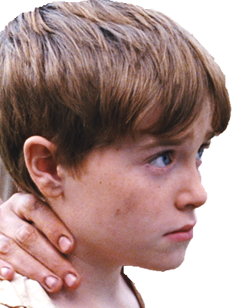
Attention writers!
The director of JAMES has decided that she wants to add another scene to the end of the film showing what happens to James. You need to write the scene.
Your script should be imaginative and dramatic, but it must also be scientifically and historically accurate.
Some questions to consider before you start writing:
What happened in real life when Dr Jenner put the smallpox pus into James’s arm? Why?
Do you know what the following words mean: cowpox, smallpox, vaccine, experiment, immunity?
Will your scene continue straight on from where the film currently ends or will it be set further in the future?
Is it going to be an exciting and tense scene (like the scene where James runs away from Dr Jenner), or is it going to be a gentler, more emotional scene (like when James’s father comes and finds him in the woods)?
Remember that James is the protagonist (the hero) of the film.
What location will you use?
Remember you are writing a film not a play.
Keep your script to less than two pages long, otherwise you won’t have enough time to film it!
Good luck!

